Slide 1

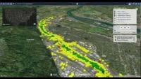


Contributing Hydro-Addressed data to geoconnex.us and the NLDI
Kyle Onda (konda@lincolninst.edu)
Associate Director, Internet of Water

Slide 2
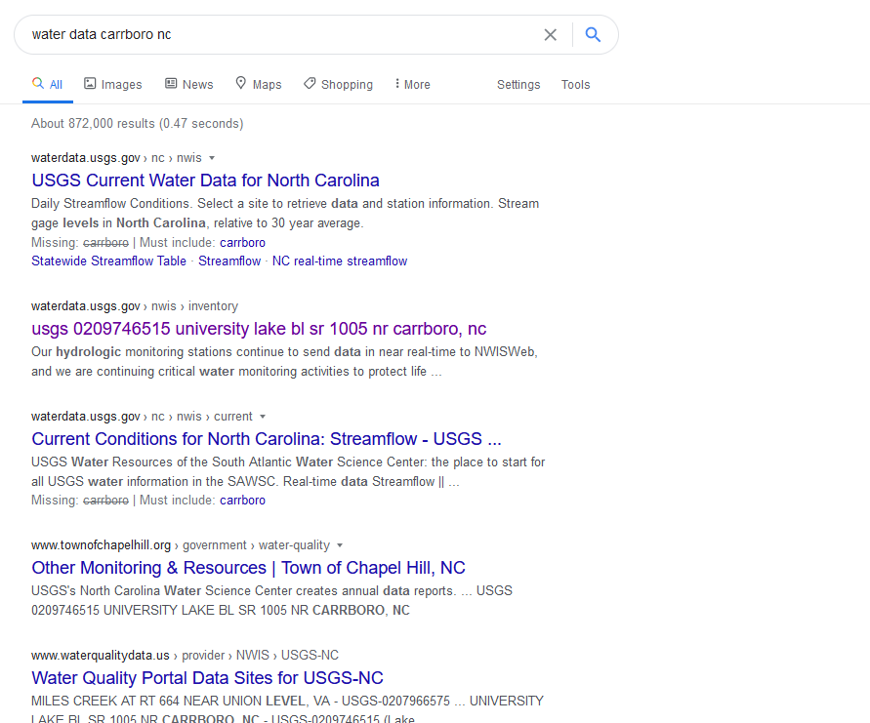
Currently…
A mix of structured and unstructured data
Dominated by USGS – administered systems
Dominated by state-wide views
Missing important topics and data providers
Like Internet Search Engines!
Via links
Notes:
The story is currently pretty different for water data. You have to know pretty much exactly what you’re looking for and who you want it from. If you were to do a general search for water data, you would get a mix of structured and unstructured data, most of it from USGS systems like NWIS or the Water Quality Portal, probably dominated by state- or nation-wide views of data without getting granular site-level information on your first look. And you’re probably missing important data providers as well as topics.

Slide 3
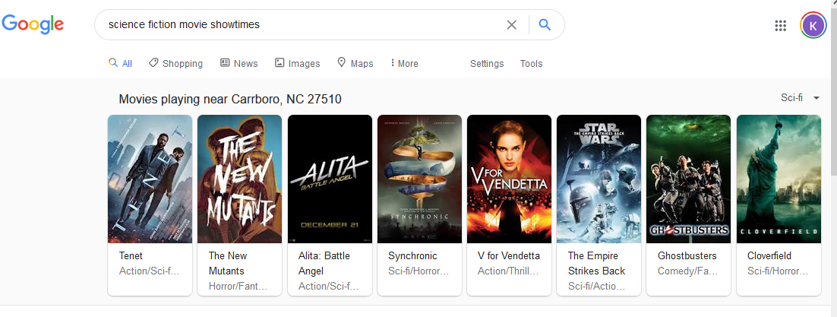
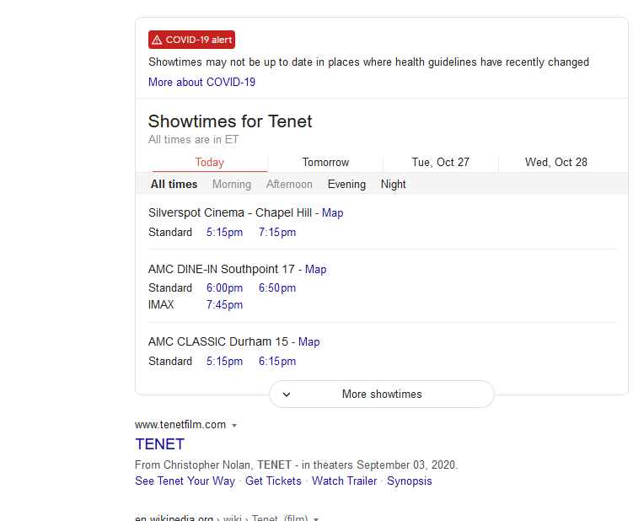
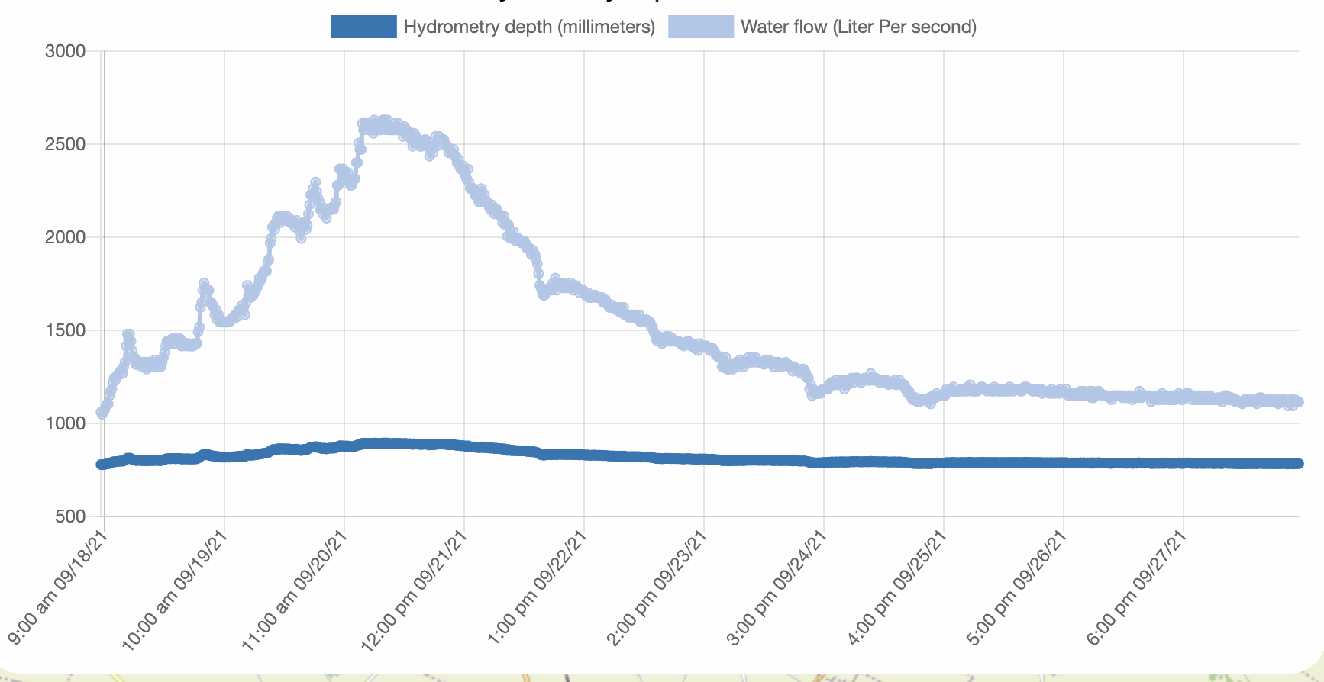
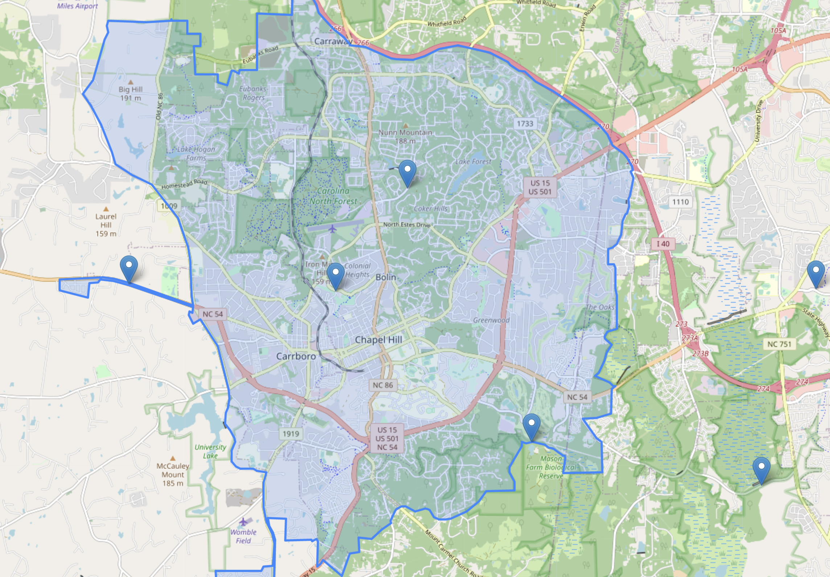
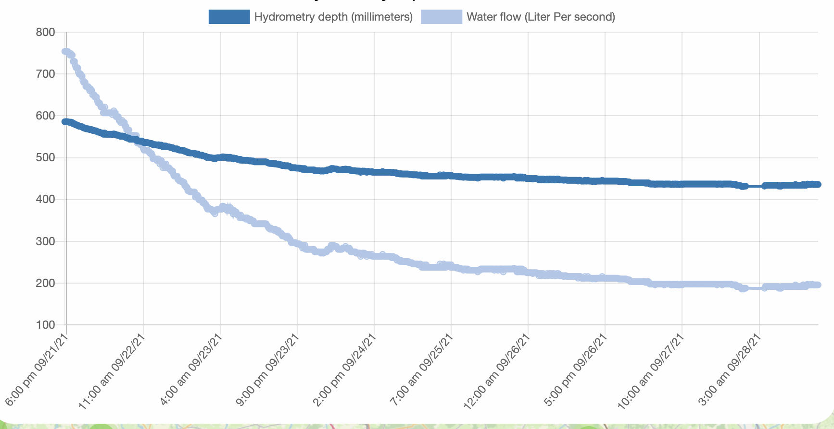
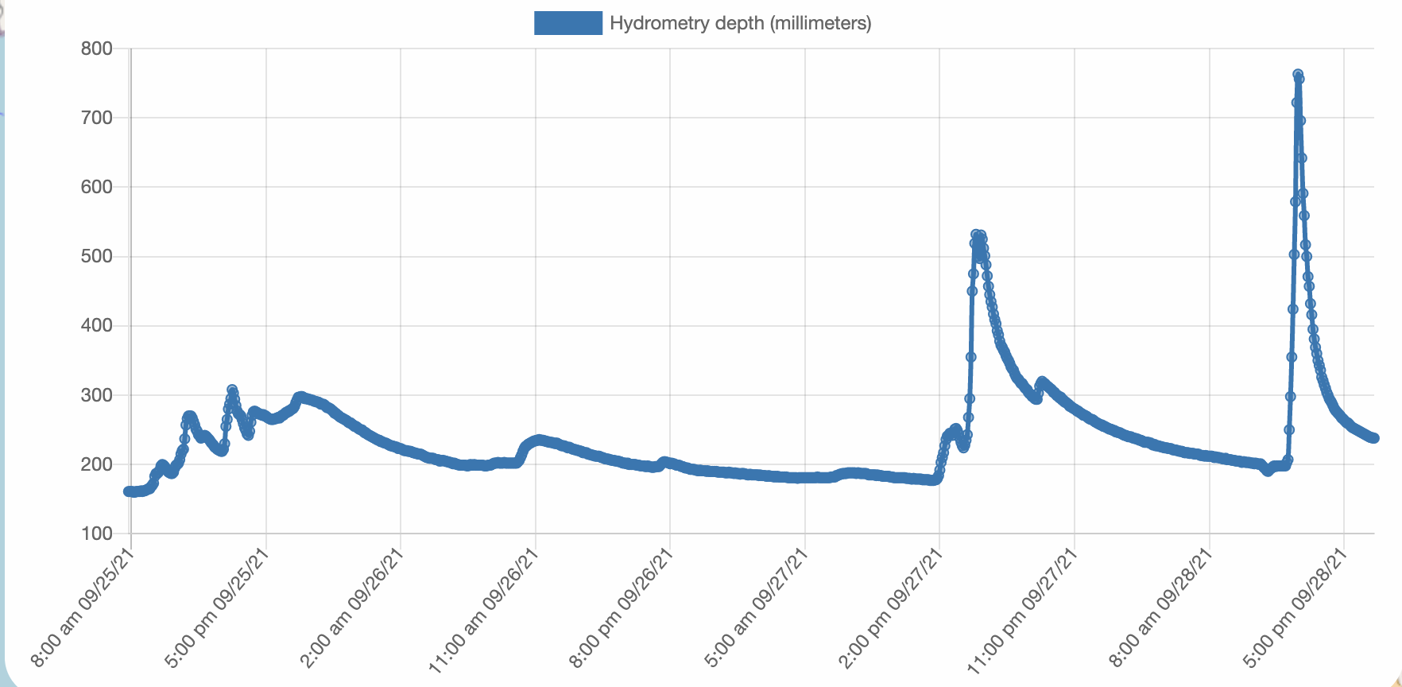
The Vision
Water data carrboro nc
Water data relevant to Carrboro, NC, 27510. Morgan Creek Watershed
Data that is...
DISCOVERABLE
Spatially - indexed
Topically - organized
Site-level granularity
No prior knowledge of water data providers required
Stream-flow
Precip- itation
Water Quality
Drinking Water Quality
Water Use
Like Internet Search Engines!
Via links
Streamflow near Carrboro NC
USGS Gages
Morgan Creek
Booker Creek
NC Department of Emergency Mgmt Gages
Station 1234B
Station 45x
Orange Water and Sewer Authority Gages
OWASA University Lake
Haw River Keeper
OWASA University Lake
Notes:
So what geoconnex aims to do is leverage the technology that is already used to organize a variety of commercial information for the purposes of making water data much more findable to both lay users and academic and professional users. You can imagine being bale to search for water data And having metadata organized for oyu by theme or topic, and having data from ALL organization well organized and presented for you. For example, you should be able to easily find data from streamgages, bot only from USGS, but also state and local agencies.

Slide 4













The Internet of Water: A vision for modern water data infrastructure connecting water data across the US so that it is Discoverable, Accessible, and Interoperable
A formal Coalition of organizations providing technology research, development, and socialization enabling the vision
A community of practice implementing the ideas developed in the Coalition, sometimes formalized as projects
NLDI

Slide 5
Outline
What is geoconnex
What is the NLDI
How to contribute to geoconnex.us
How to contribute to the NLDI
NLDI Demo

Slide 6




geoconnex.us Community
Funded By:
Developed by:
Operated by:
Data contributed
(so far) by:

Slide 7
Motivations
“As a user of water data, I need to discover and access water information relevant to the environmental feature I care about from all the organizations that hold data about it, so I don’t have to have special knowledge to access some information and so I don’t miss some potentially relevant information.”
A water-specific search index that links data to geographic features like streams, watersheds, aquifers, and administrative boundaries
A free, open-source software suite that lets data providers automate the process of ingesting data, standardizing data, serving through an API, and serving relevant metadata
Guidance and basic data extraction tools that make it easier for users to access data from already existing hubs, such as Water Quality Portal
Dave Blodgett (USGS)
Second Environmental Linked Features Experiment: (https://docs.ogc.org/per/20-067.html
Notes:
Where does geoconnex come from. Basically it comes out of the intenrnational Stream of work at the open geospatial Consortium (the OGC) called the itneroperability experiments. Dave Blodgett from USGS had a leadership role in these experiments, the lessons of which form the core ideas behind geoconnex, and I work directly with him on this project. He also expressed the general motivating user story. “As a user of water data, I need to discover and access water information relevant to the environmental feature I care about from ALL organizations that hold data bout it, so I dont’ve have to have special knowledge to access osme information and so I don’t miss some potentially relevant information. Meaning basically, I want all the data but I don’t want to have to know where all that data lives ahead of time.

Slide 8







Geoconnex – The Discoverability framework for the internet of water, enabling conditions for a knowledge graph of water-related data without centralizing data governance and storage
Observed or Modeled Data
Observed or Modeled Data
about
about
Hydrologically related
Real-world feature/location of interest
Real-world feature/location of interest

Slide 9
Geoconnex – enabling conditions for a knowledge graph of water-related data without centralizing data governance and storage
How do we enable computers to infer and leverage relationships between heterogeneous online data?
Observed or Modeled Data
Observed or Modeled Data
about
about
Hydrologically related
Real-world feature/location of interest
Real-world feature/location of interest

Slide 10
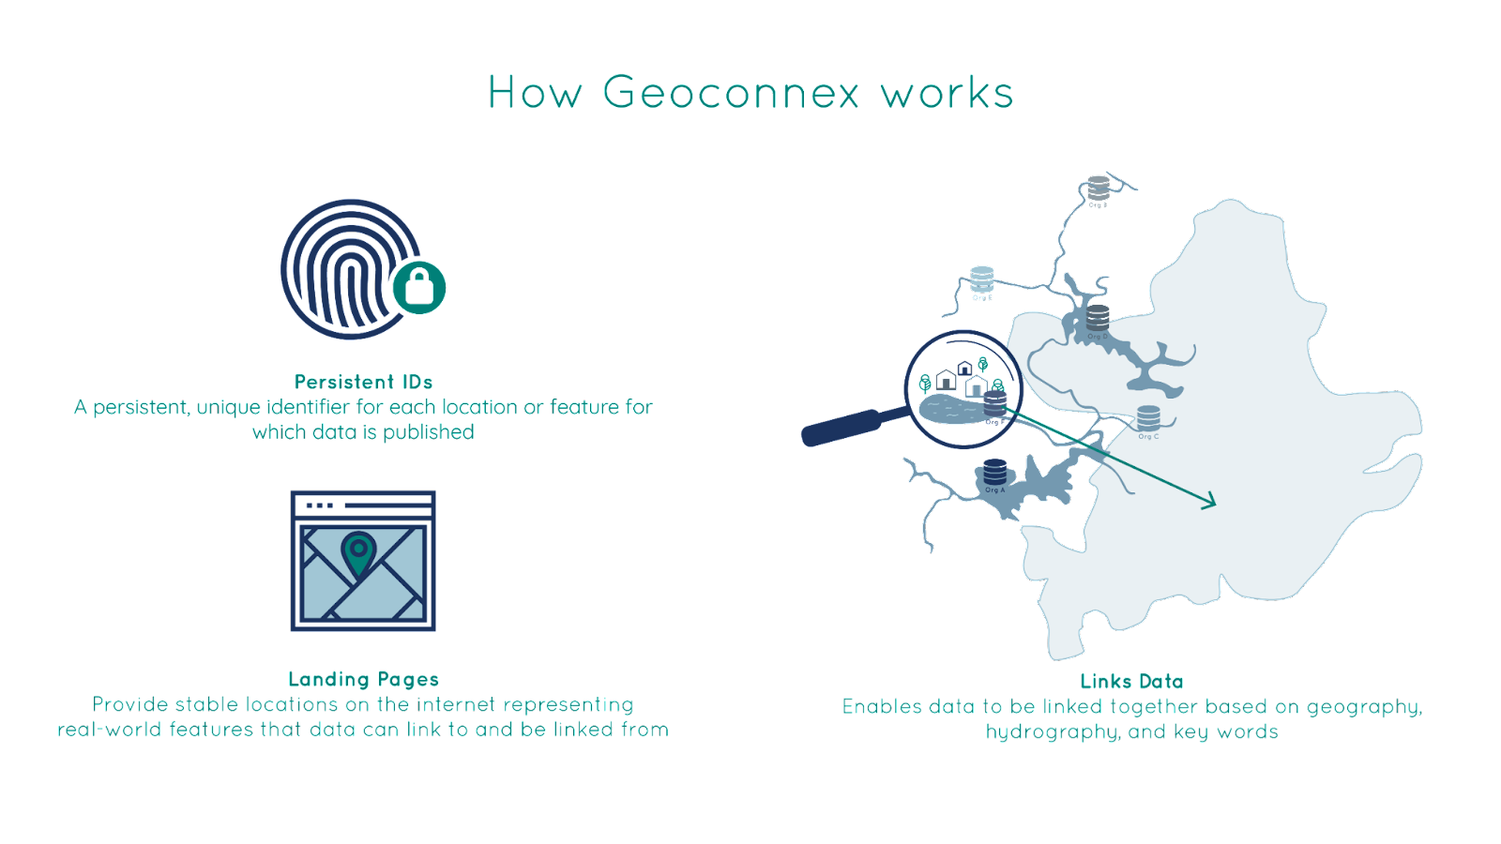
Requirement 1: All sites and environmental features should have universal, persistent identifiers
(URL)
(URL)
identify
identify
Hydrologically related
Real-world feature/location of interest
Real-world feature/location of interest

Slide 11
Requirement 2: Each individual persistent identifier should resolve/point/redirect to an individual landing page (webpage) about the identified feature
Landing page
point to
(URL)
(URL)
identify
identify
Hydrologically related
Real-world feature/location of interest
Real-world feature/location of interest

Slide 12

Requirement 3: Landing pages should embed structured metadata, describing the feature…
Landing page
include
point to
Structured/Linked Data
(JSON-LD)
(URL)
(URL)
describe
identify
identify
Hydrologically related
Real-world feature/location of interest
Real-world feature/location of interest

Slide 13
Requirement 3: Landing pages should embed structured metadata, describing the feature…
Landing page
This can be a sticking point. 2,000 sensors = 2,000 webpages!
include
point to
Structured/Linked Data
(JSON-LD)
(URL)
(URL)
describe
identify
identify
Hydrologically related
Real-world feature/location of interest
Real-world feature/location of interest

Slide 14
Requirement 3: Landing pages should embed structured metadata, describing the features…
And linking to relevant data sources and the persistent identifiers of related features
Landing page
include
point to
Include links to
Include links to
Observed or Modeled Data
Structured/Linked Data
(JSON-LD)
about
(URL)
(URL)
describe
identify
identify
Hydrologically related
Real-world feature/location of interest
Real-world feature/location of interest

Slide 15
https://geoconnex.us
(persistent identifier registry and resolver)
https://geoconnex.us/sitemap.xml
Reference
Features
Special features common across organizations (e.g. NHD, PLSS, HUCs, census geographies)

Slide 16

https://geoconnex.us
(persistent identifier registry and resolver)
https://geoconnex.us/sitemap.xml
Reference
Features
Embedded
JSON-LD
Organizational
Monitoring locations

Slide 17
https://geoconnex.us
(persistent identifier registry and resolver)
https://geoconnex.us/sitemap.xml
Reference
Features
Embedded
JSON-LD
Organizational
Monitoring locations
docs.geoconnex.us
JSON-LD guidance, templates, schemas, vocabularies. Derived from SELFIE (HY_Features, schema.org, SOSA/SSN)

Slide 18



harvest.geoconnex.us
https://geoconnex.us
(persistent identifier registry and resolver)
https://geoconnex.us/sitemap.xml
Reference
Features
Knowledge graph
(graph database)
APIs
Embedded
JSON-LD
Organizational
Monitoring locations
search.geoconnex.us
graph.geoconnex.us
reference.geoconnex.us
docs.geoconnex.us
JSON-LD guidance, templates, schemas, vocabularies. Derived from SELFIE (HY_Features, schema.org, SOSA/SSN)

Slide 19
Authoring Guidance
Data user community
Influences
Used By
Influences
Used By
Data Publishers
Indexer
Enables

Slide 20

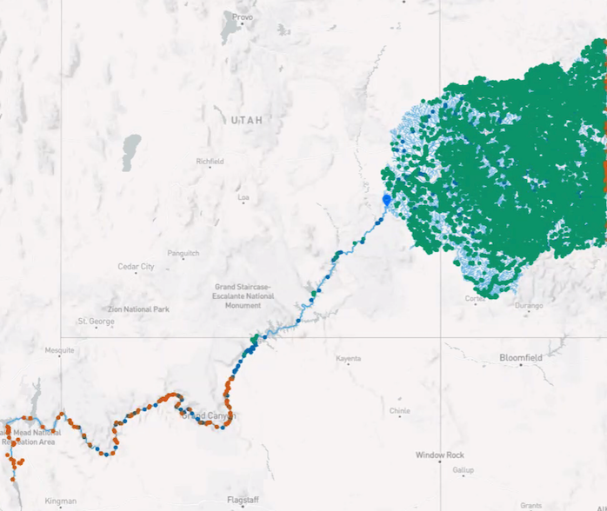
What is the NLDI?
A RESTful application programming interface (API) in front of the NHD (NHDPlusV2 for now, HR support eventually)
An open-source project with the codebase available at https://github.com/internetofwater/nldi-services
Hosted by USGS
https://labs.waterdata.usgs.gov/about-nldi/index.html

Slide 21
How to contribute to geoconnex.us and the NLDI
Hydro-address your location data (see Mike Tinker’s presentation)
geoconnex steps
Publish feature-level landing content with embedded JSON-LD and persistent identifiers
Mint persistent identifiers with https://geoconnex.us
NLDI Steps
Publish a geojson file with your hydro-addressed location data (can be same as step 2)
Register your geojson file with the NLDI repository

Slide 22
1. Hydro Address your data
Use HydroAdd to add NHD Reachcodes and Measures to your locations
Example: https://github.com/internetofwater/gwtc2022-workshop/blob/main/landing_pages/data/data.csv

Slide 23
2. Publish feature-level landing content with embedded JSON-LD and persistent identifiers
Create a persistent identification scheme:
https://geoconnex.us/my-org/topic/.../hierarchy/12345
Examples:
https://geoconnex.us/usgs/monitoring-location/08332622
https://geoconnex.us/epa/hmw/030300020607
stem
namespace
id

Slide 24
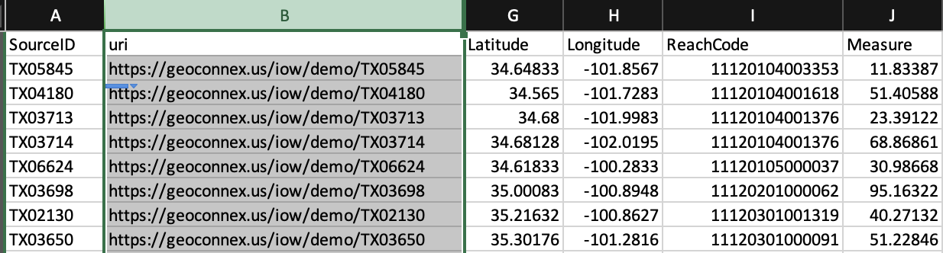
2. Publish feature-level landing content with embedded JSON-LD and persistent identifiers
2. Add the persistent identifiers to your data
Example: https://github.com/internetofwater/gwtc2022-workshop/blob/main/landing_pages/data/data.csv

Slide 25
2. Publish feature-level landing content with embedded JSON-LD and persistent identifiers
3. Publish your data so that each spatial feature has a website with:
a. It’s own URL
b. A human-readable HTML version
c. metadata formatted as JSON-LD
standardized vocabularies for interoperability with other data
links to common features (like NHD, states/counties/census tracts, etc.)
Example:
https://www.arcgis.com/home/webmap/viewer.html?url=https://services5.arcgis.com/9b85MAhVnAUWydgW/ArcGIS/rest/services/gwtc_2022_demo_data_(Feature_Service)/FeatureServer/0&source=sd

Slide 26
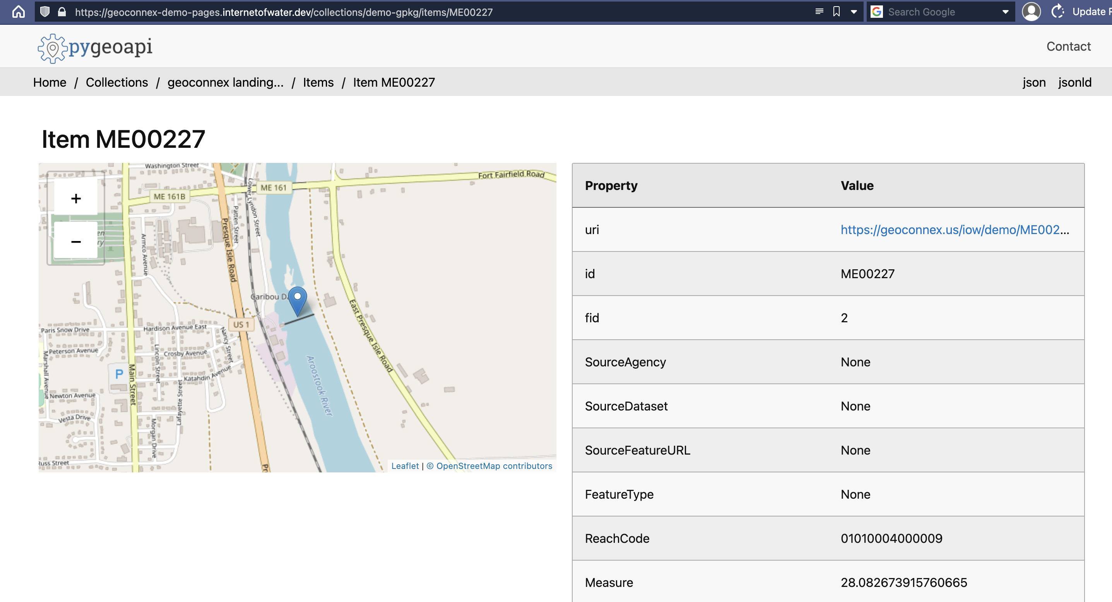

Slide 27
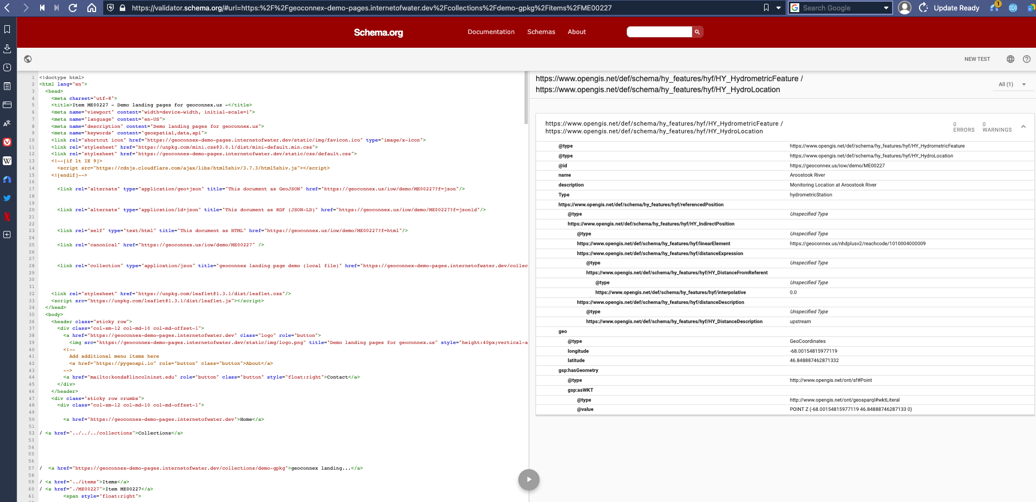
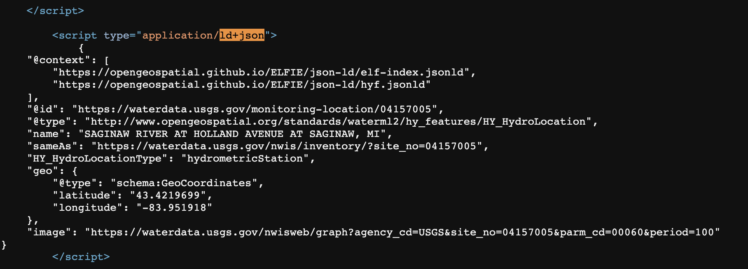
<script type="application/ld+json">
 | {
 | "@context": [
 | "https://opengeospatial.github.io/ELFIE/json-ld/elf-index.jsonld",
 | "https://opengeospatial.github.io/ELFIE/json-ld/hyf.jsonld"
 | ],
 | "@id": "https://waterdata.usgs.gov/monitoring-location/04157005",
 | "@type": "http://www.opengeospatial.org/standards/waterml2/hy_features/HY_HydroLocation",
 | "name": "SAGINAW RIVER AT HOLLAND AVENUE AT SAGINAW, MI",
 | "sameAs": "https://waterdata.usgs.gov/nwis/inventory/?site_no=04157005",
 | "HY_HydroLocationType": "hydrometricStation",
 | "geo": {
 | "@type": "schema:GeoCoordinates",
 | "latitude": "43.4219699",
 | "longitude": "-83.951918"
 | },
 | "image": "https://waterdata.usgs.gov/nwisweb/graph?agency_cd=USGS&site_no=04157005&parm_cd=00060&period=100"
 | }
 | </script>

Slide 28
What to put in JSON-LD?
Templates: https://docs.geoconnex.us/templates/intro-full.html

Slide 29
2. Publish feature-level landing content with embedded JSON-LD and persistent identifiers
How?
Templating systems: https://en.wikipedia.org/wiki/Web_template_system
Turnkey solution:
Pygeoapi: https://pygeoapi.io
Internet of Water version: https://github.com/internetofwater/pygeoapi
Docker image: internetofwater/pygeoapi:stable
Can generate landing pages and JSON-LD from:
csv, geojson, shp, geopackage/SQLite
PostGIS
OGC WFS
ESRI FeatureServer/MapServer

Slide 30
3. Mint persistent identifiers with https://geoconnex.us
Like a URL shortener, for your features!
https://geoconnex.us/your-org/123 -> 303 redirect ->
https://yourorg.com/sites/123
or
https://yourorg-newwebsite.com/api?site=123
or …

Slide 31
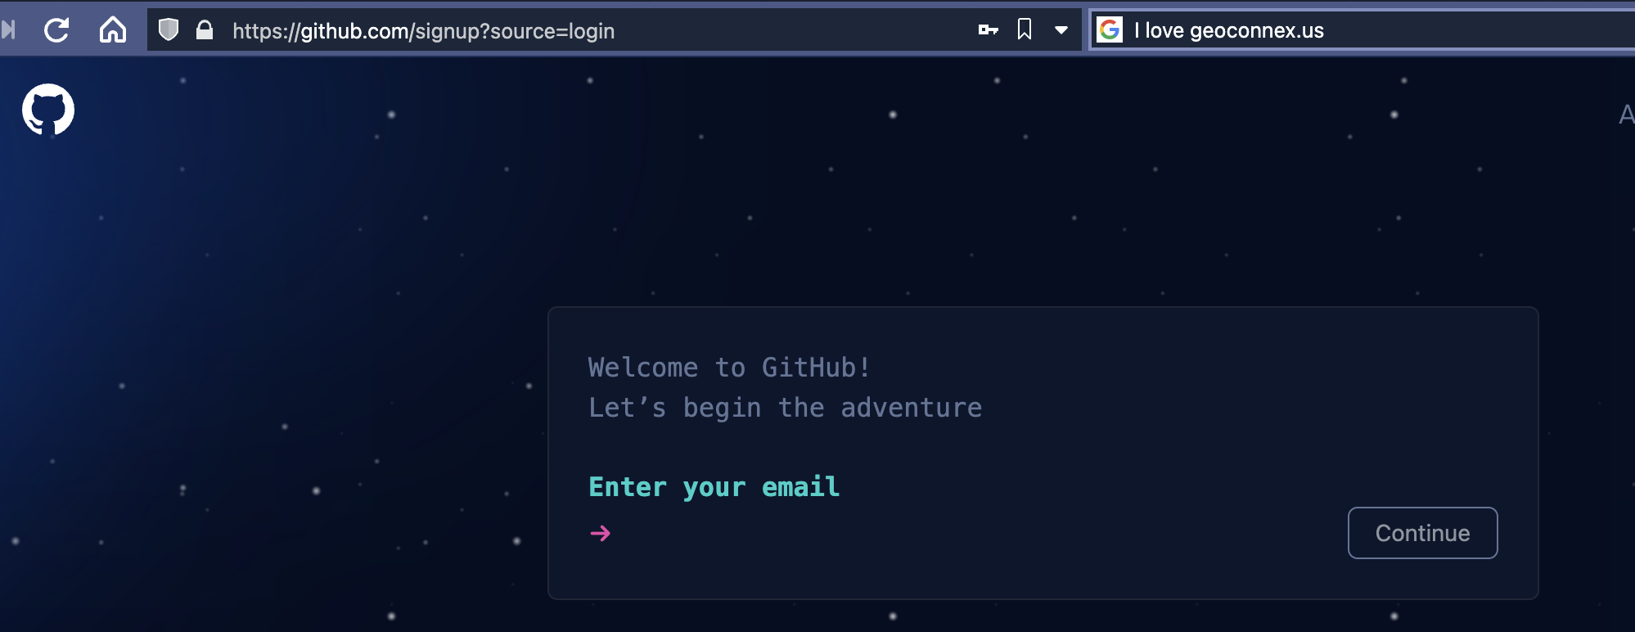
3. Mint persistent identifiers with https://geoconnex.us
Step 0: Create a Github account

Slide 32
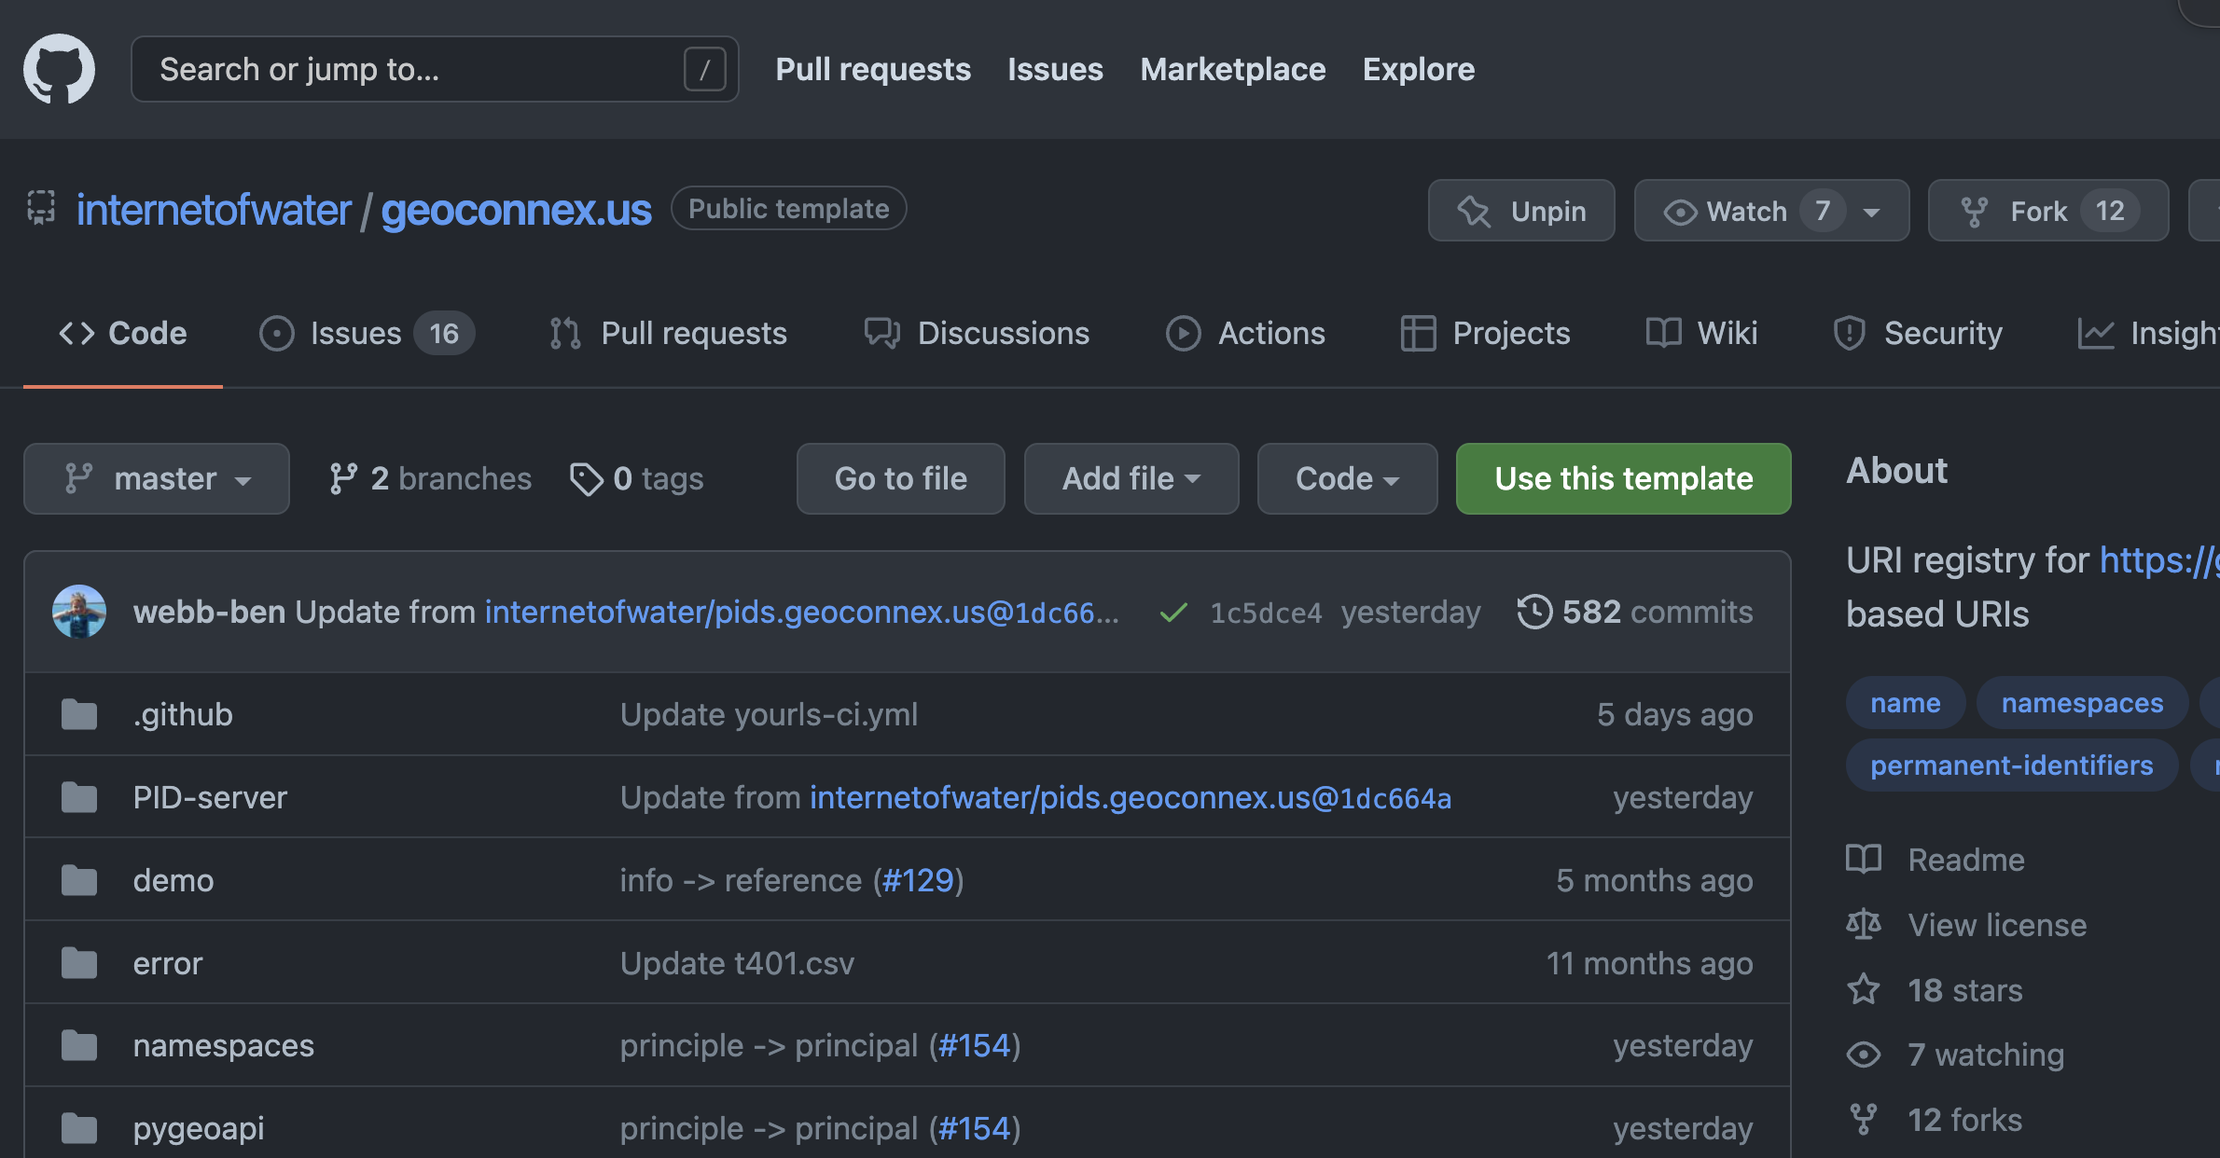
3. Mint persistent identifiers with https://geoconnex.us
Step 1: Fork the repository: https://github.com/internetofwater/geoconnex.us

Slide 33
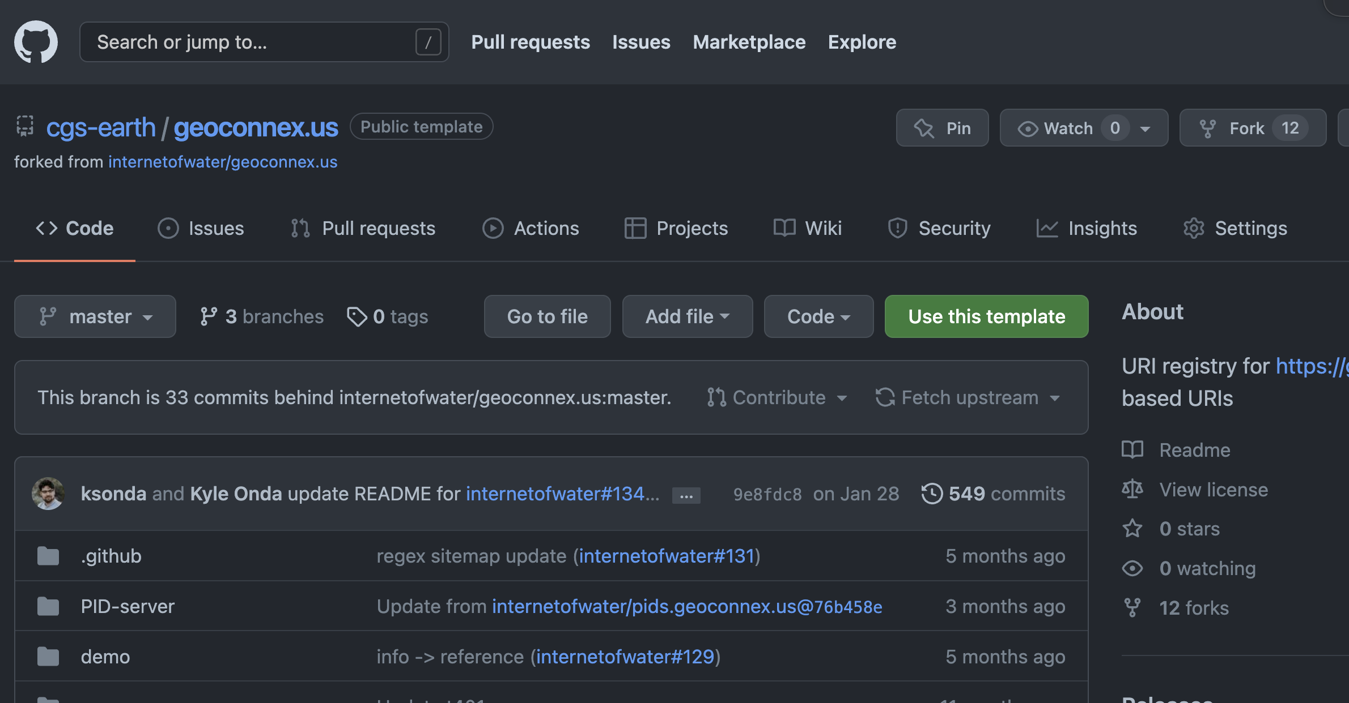
3. Mint persistent identifiers with https://geoconnex.us
Step 1: Fork the repository: https://github.com/internetofwater/geoconnex.us

Slide 34
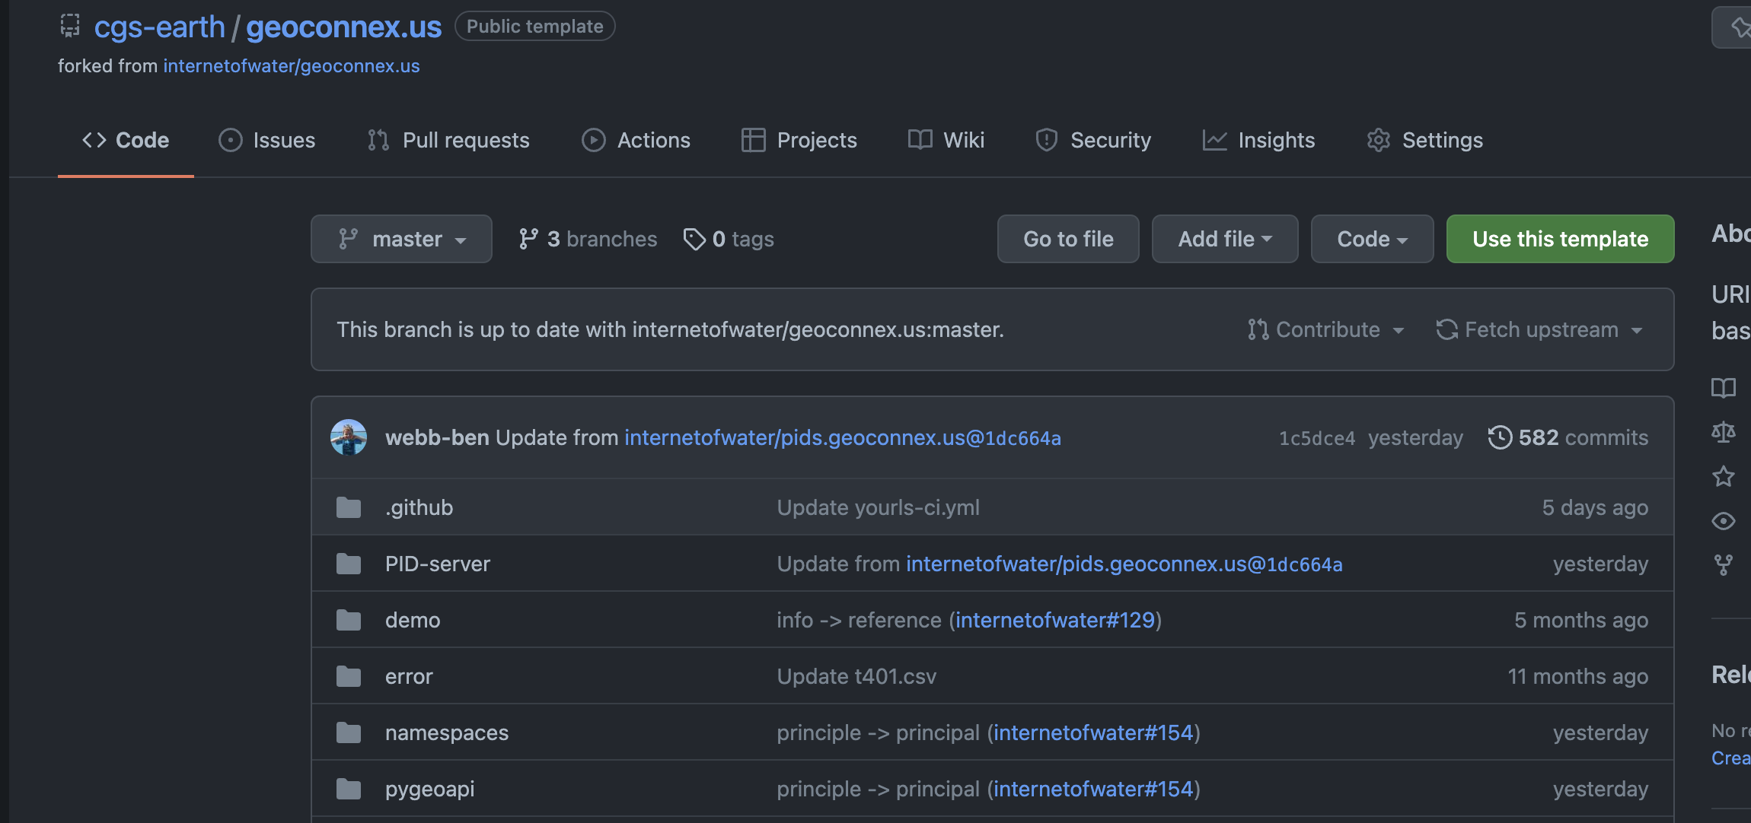
3. Mint persistent identifiers with https://geoconnex.us
Step 2: Add your own namespace

Slide 35
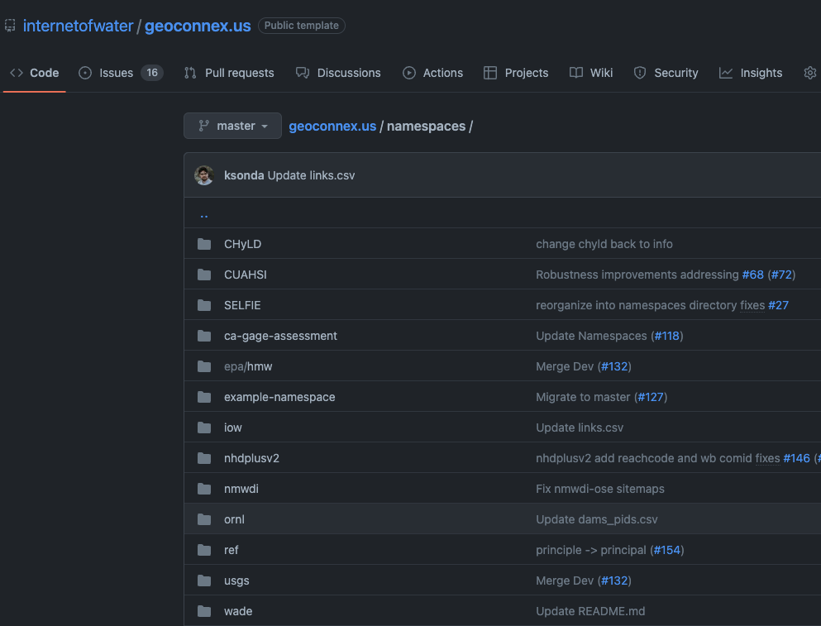
3. Mint persistent identifiers with https://geoconnex.us
Step 2: Add your own namespace

Slide 36
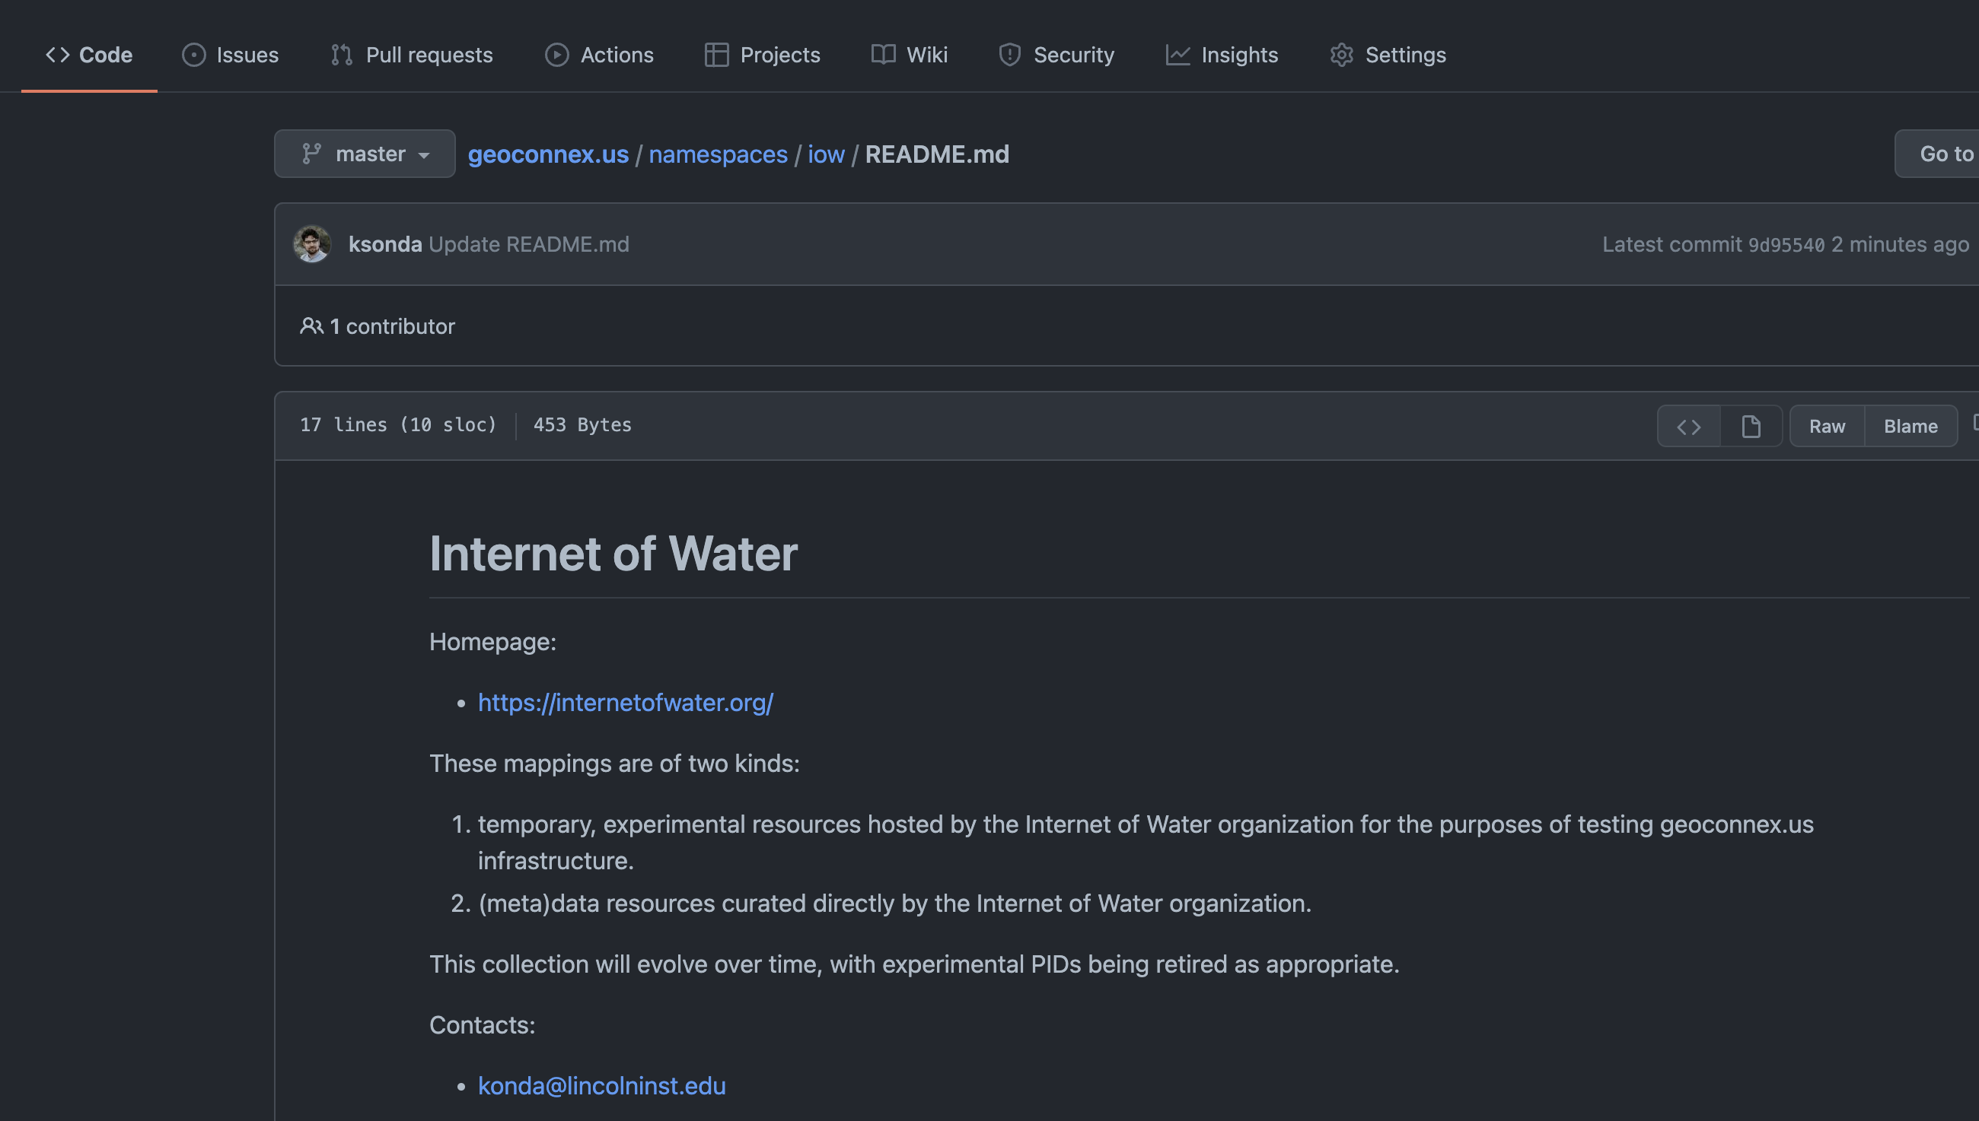
3. Mint persistent identifiers with https://geoconnex.us
Step 2: Add your own namespace (and make a descriptive README)

Slide 37
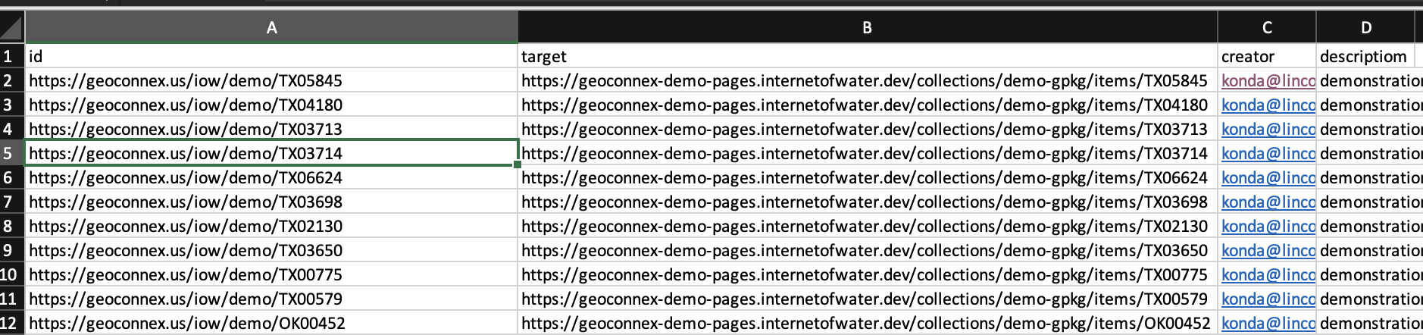
3. Mint persistent identifiers with https://geoconnex.us
Step 3: Create a csv in the following format
The persistent ID for each feature
The URL for the landing page you want the ID to redirect to

Slide 38
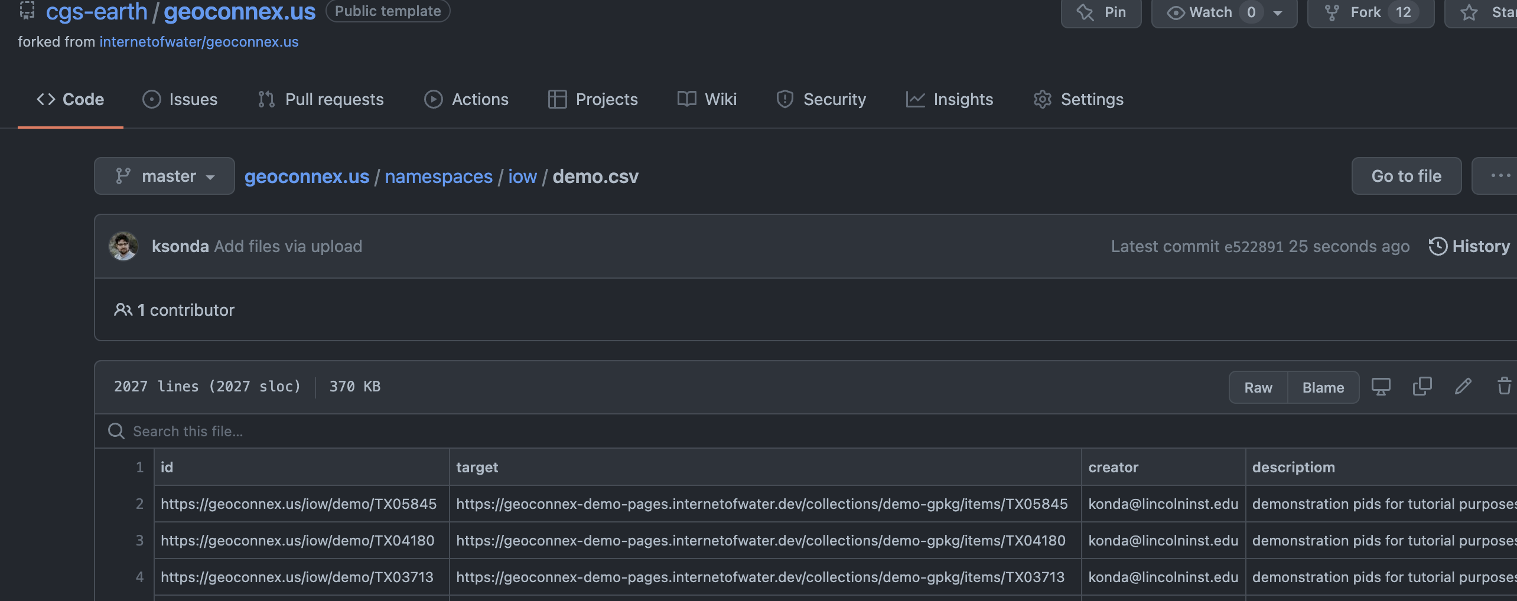
3. Mint persistent identifiers with https://geoconnex.us
Step 4: Add the csv to your namespace folder

Slide 39
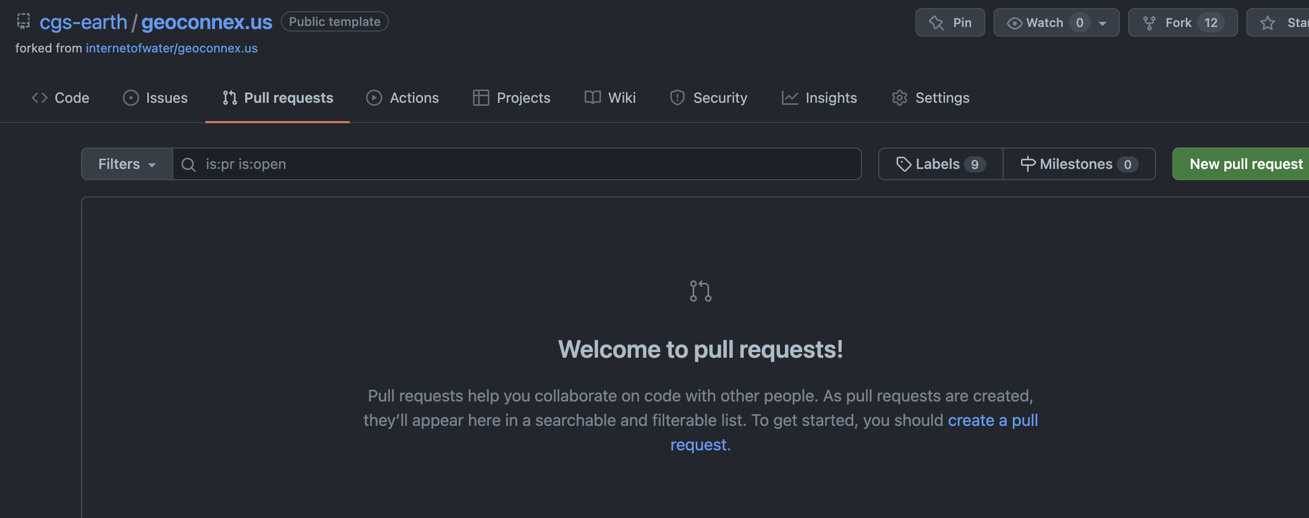
3. Mint persistent identifiers with https://geoconnex.us
Step 5: Open a pull request to the main repository

Slide 40
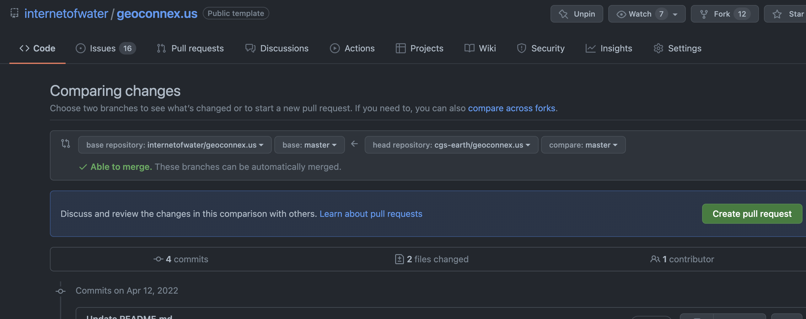
3. Mint persistent identifiers with https://geoconnex.us
Step 5: Open a pull request to the main repository

Slide 41
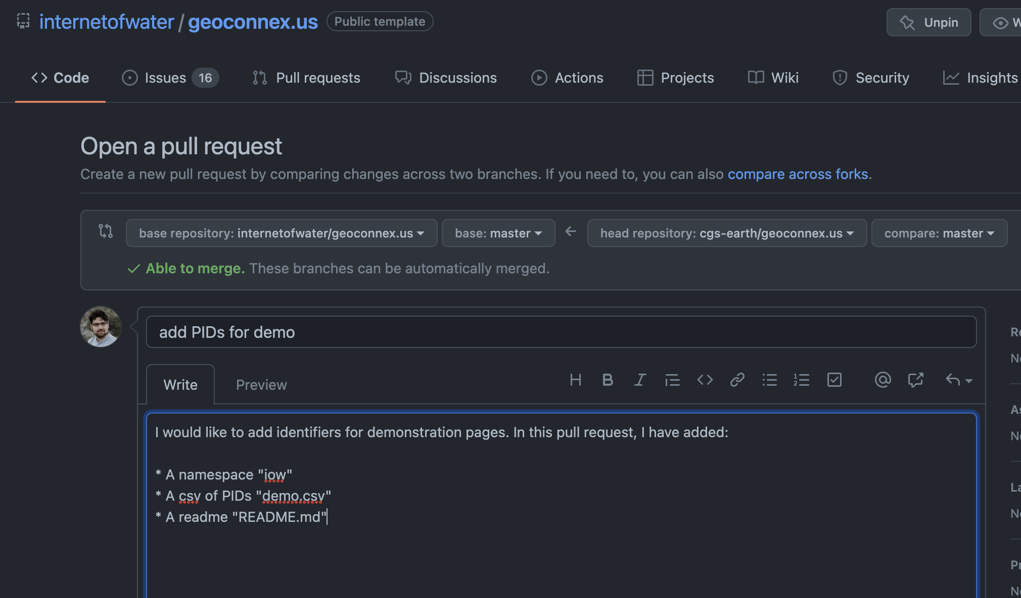
3. Mint persistent identifiers with https://geoconnex.us
Step 5: Open a pull request to the main repository

Slide 42
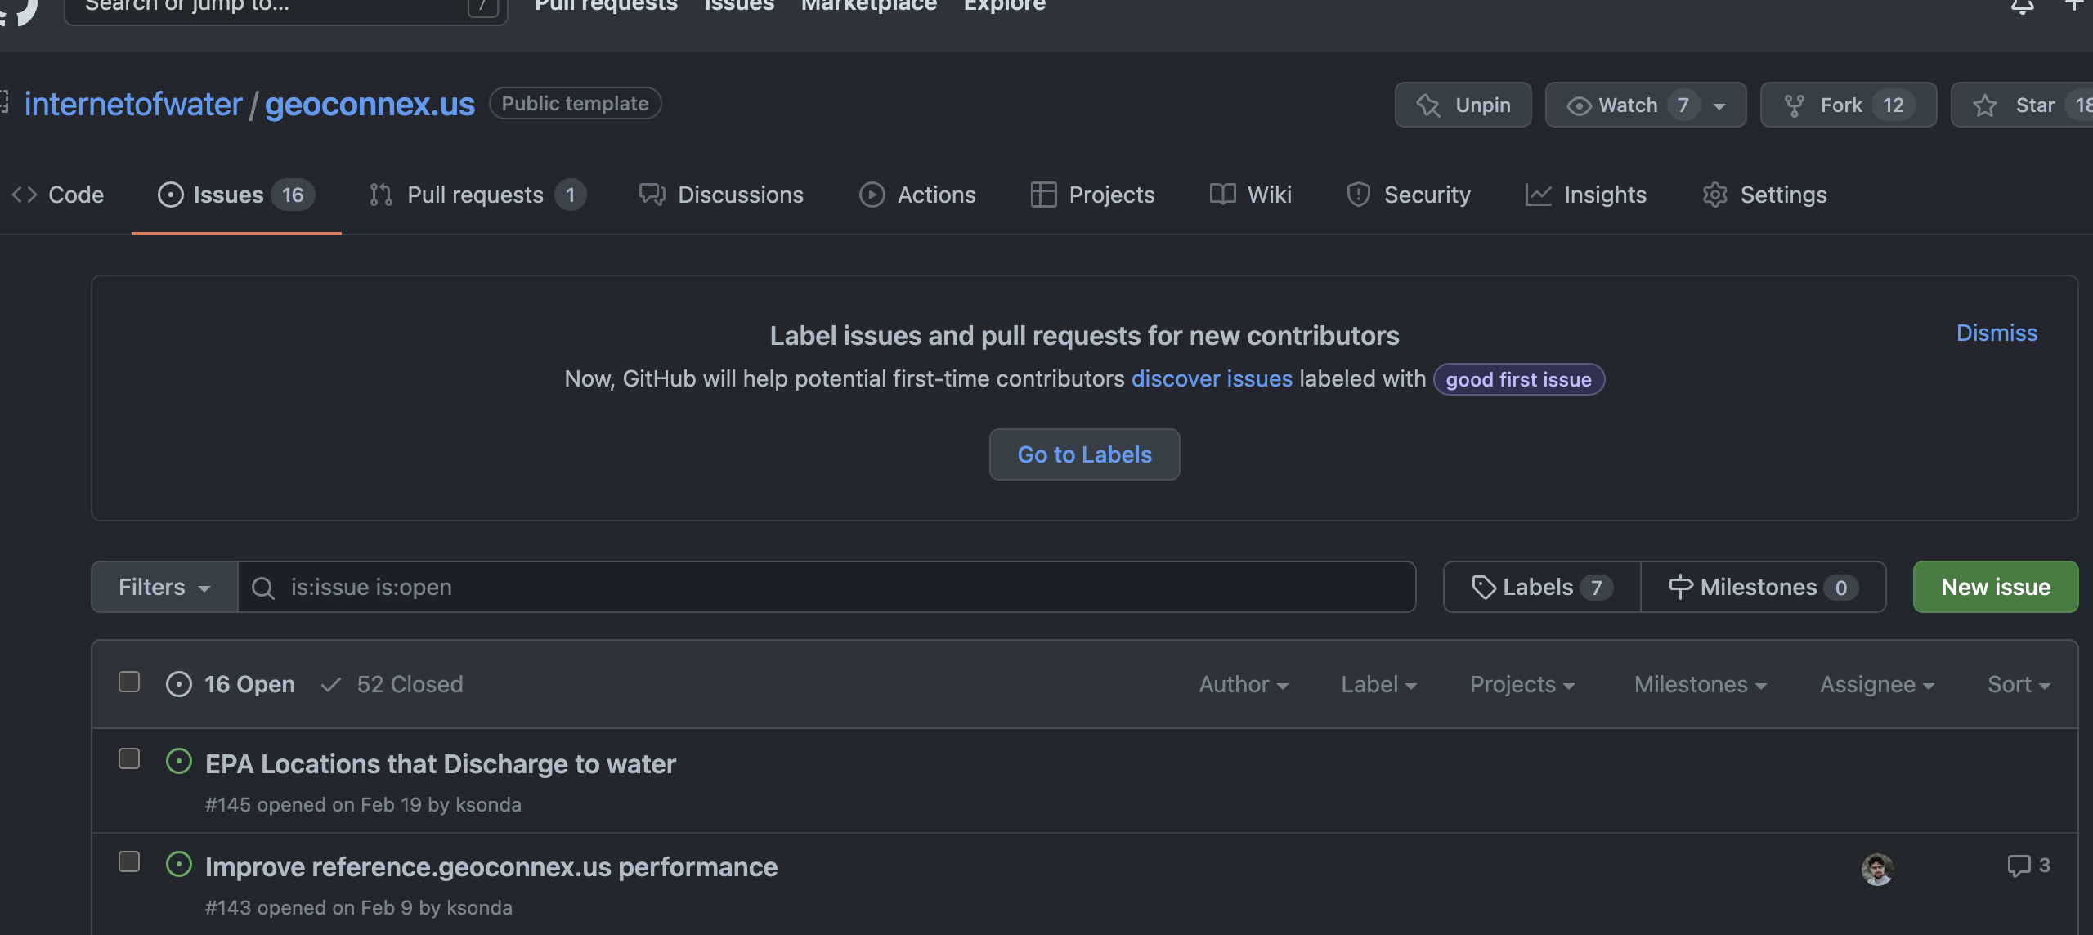
3. Mint persistent identifiers with https://geoconnex.us
Step 6: Wait for your pull request to be approved
Alternative to Steps 1-6: Open an Issue and ask the geoconnex.us team to help you directly!

Slide 43
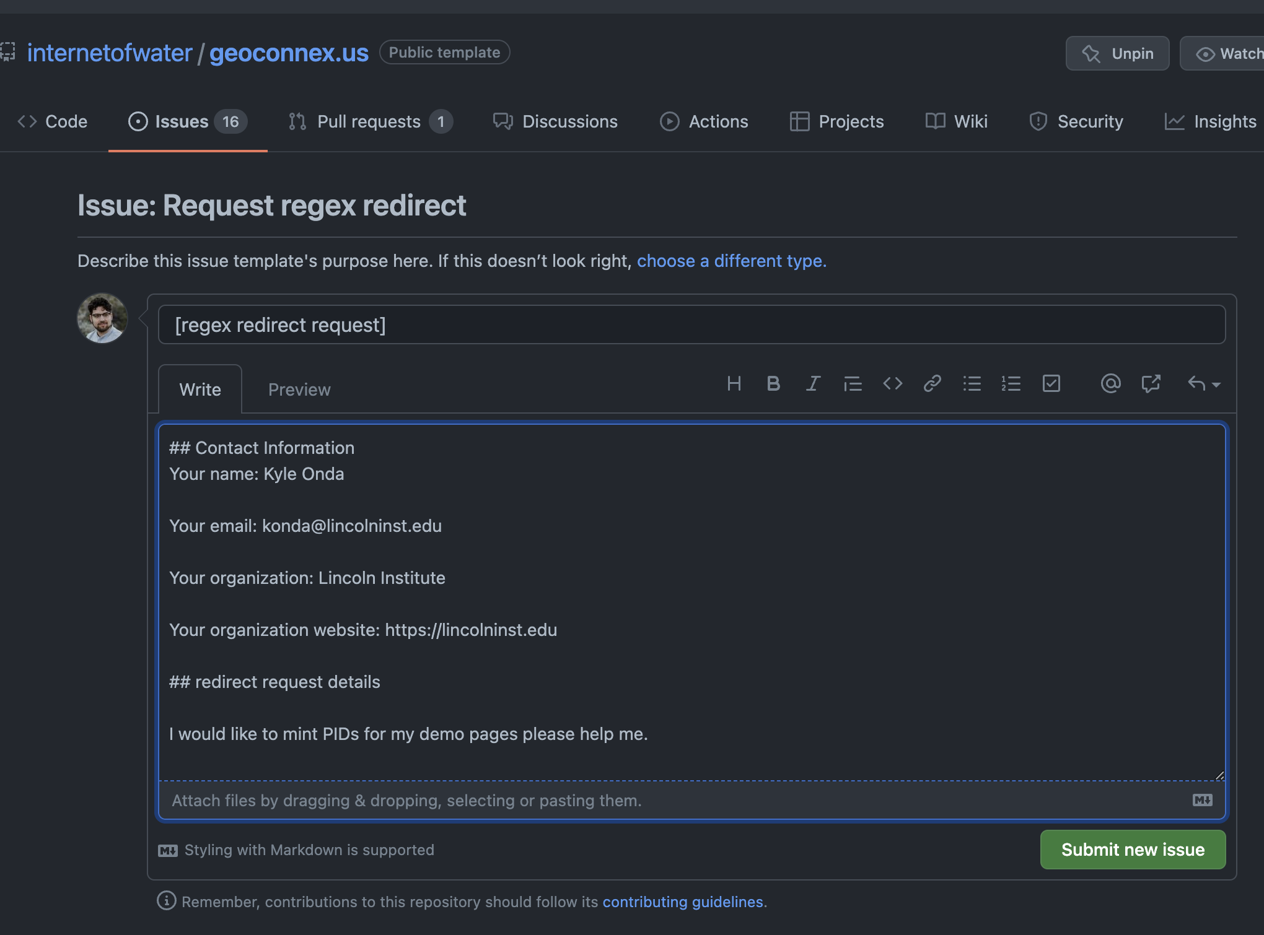
3. Mint persistent identifiers with https://geoconnex.us
Step 6: Wait for your pull request to be approved
Alternative to Steps 1-6: Open an Issue and ask the geoconnex.us team to help you directly!

Slide 44
3. Mint persistent identifiers with https://geoconnex.us
Step 7: Try your PIDs!
https://geoconnex.us/iow/demo/TX05845

Slide 45
Now let’s contribute data to the NLDI

Slide 46
4. Publish a geojson file with your hydro-addressed location data
The NLDI requires a geojson file accessible from a URL (API or data repository) with at least columns that include the following concepts
id: a unique alphanumeric identifier for the feature within the file
uri: url pointing to a particular feature web resource where more information can be found (this can be a geoconnex PID)
name: name for the feature
Reach (optional): the NHD reachcode from the feature’s hydrologic address (NHDPlusV2 for now, NHDHR coming)
Measure (optional): the measure along the reachcode from the hydrologic address

Slide 47
4. Publish a geojson file with your hydro-addressed location data
Option 1: URL for GeoJSON output from a web service
NOTE: No pagination allowed (e.g., only <2,000 features for ESRI FeatureServer)
NOTE: Ensure output is in WGS84 CRS
NOTE: Endpoint must be publicly available (no authentication)
Examples:
ESRI Feature Service: https://services5.arcgis.com/9b85MAhVnAUWydgW/ArcGIS/rest/services/gwtc_2022_demo_data_(Feature_Service)/FeatureServer/0/query?where=1%3D1&outFields=*&outSR=4326&f=pgeojson
Pygeoapi (same as internet of water landing page generator):
https://geoconnex-demo-pages.internetofwater.dev/collections/demo-gpkg/items?f=json&limit=10000

Slide 48

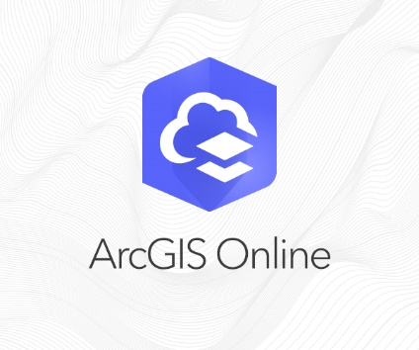

4. Publish a geojson file with your hydro-addressed location data
Option 2 (>2,000 features or so): Create a separate geojson file with the fields, and place at a publicly available location with a http(s) URL (NO AUTHENTICATION). Examples:
University dataverse
Personal website
https://lincolninstitute.maps.arcgis.com/sharing/rest/content/items/89f9aa64d7ff47dd8bd2548385f3bc02/data

Slide 49
5. Register your geojson file with the NLDI repository
Submit an issue at this GitHub repository
https://github.com/internetofwater/nldi-services
email dblodgett@usgs.gov

Slide 50





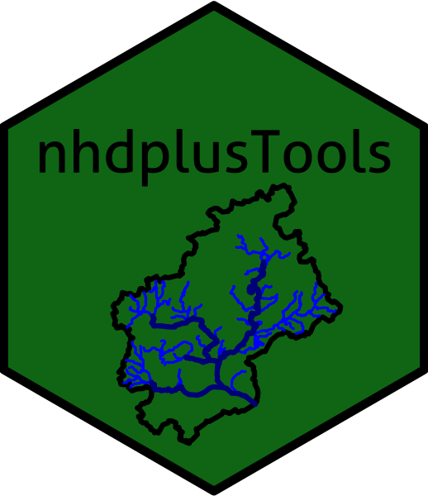

NLDI – How to use
Swagger docs:
https://labs.waterdata.usgs.gov/api/nldi/swagger-ui/index.html
HTTP GET requests ->
Receive GeoJSON ->
Use in analysis, GIS software, custom web applications

Slide 51
NLDI – How to use (Demo)
https://geoconnex.us/iow/nldi/demo

Slide 52
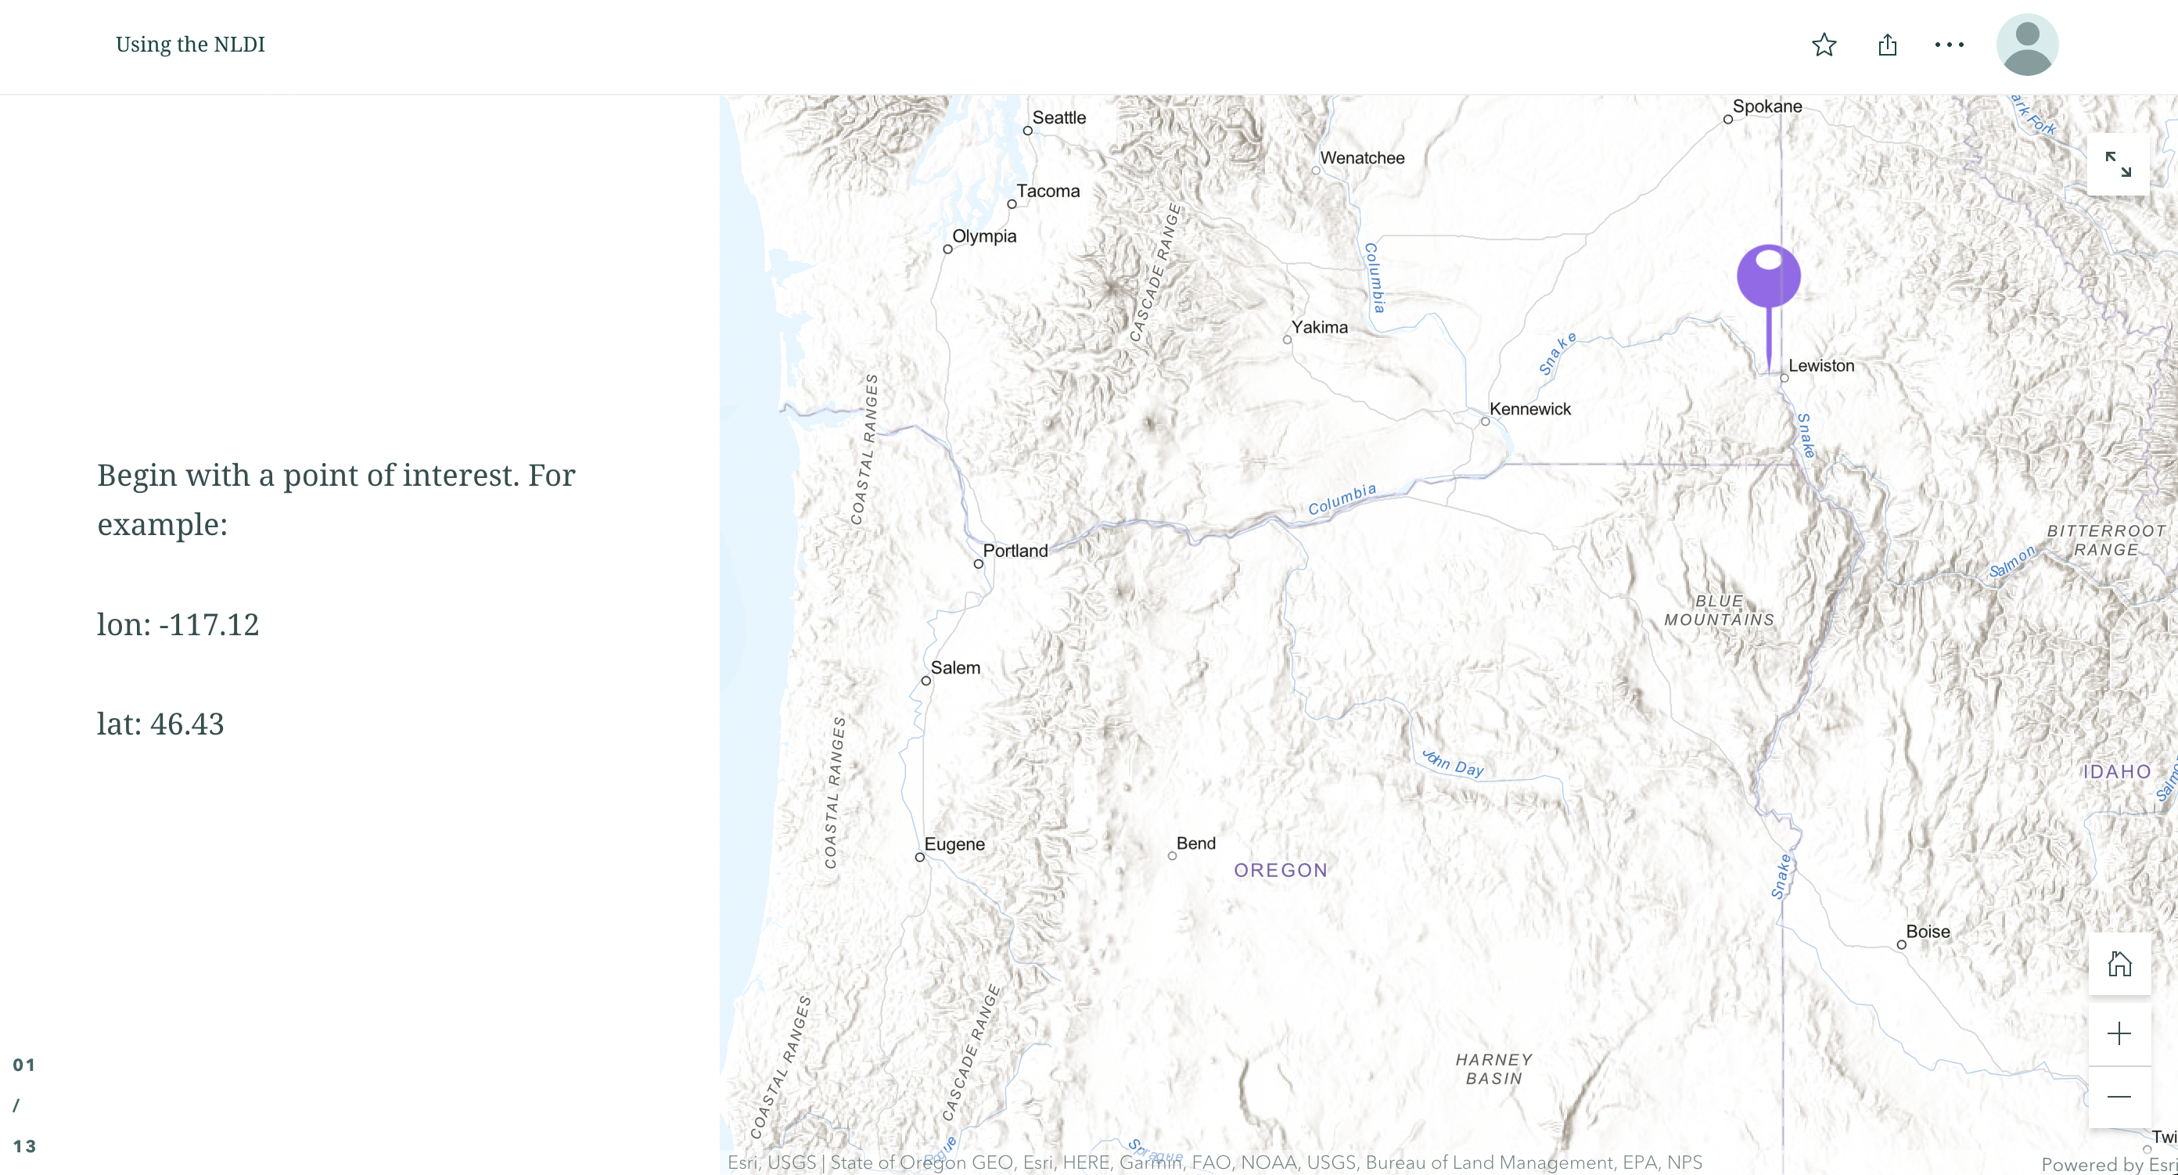

Slide 53
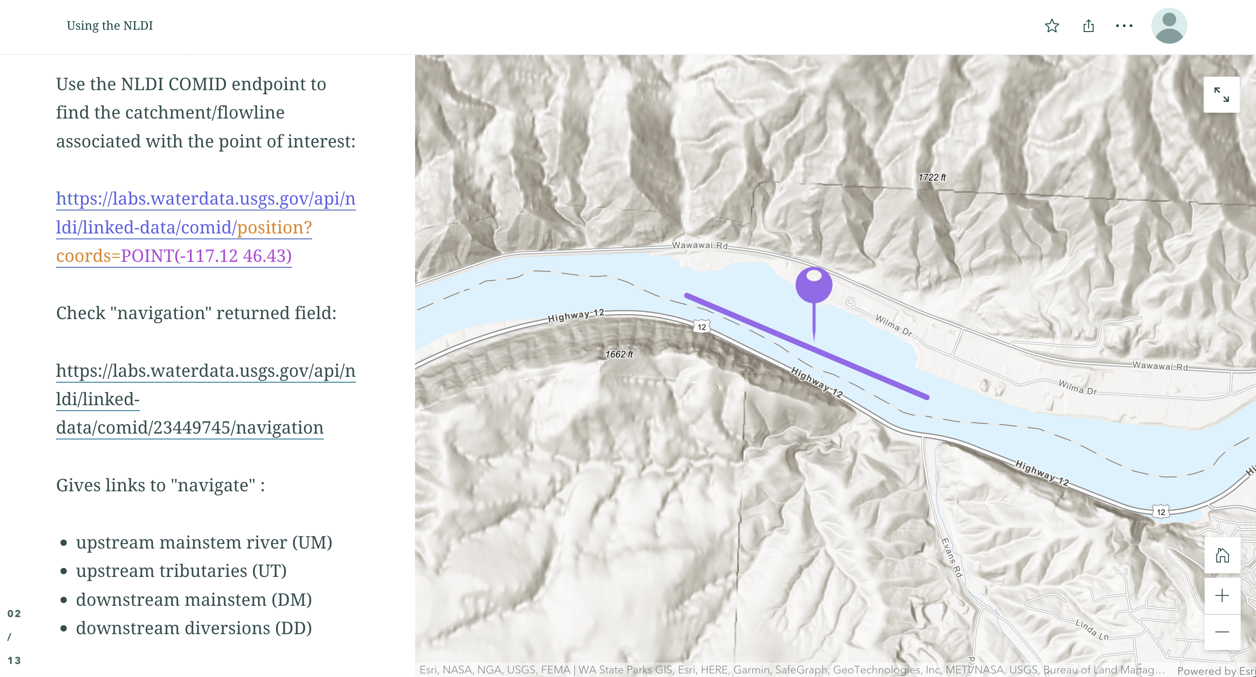

Slide 54
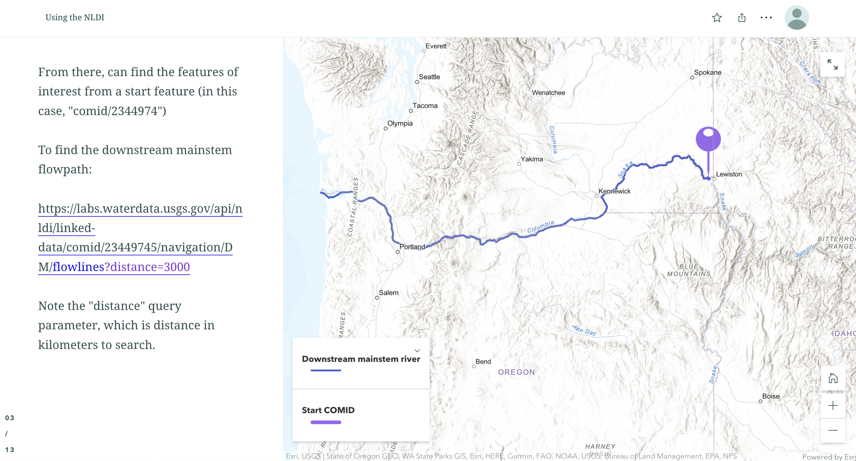

Slide 55
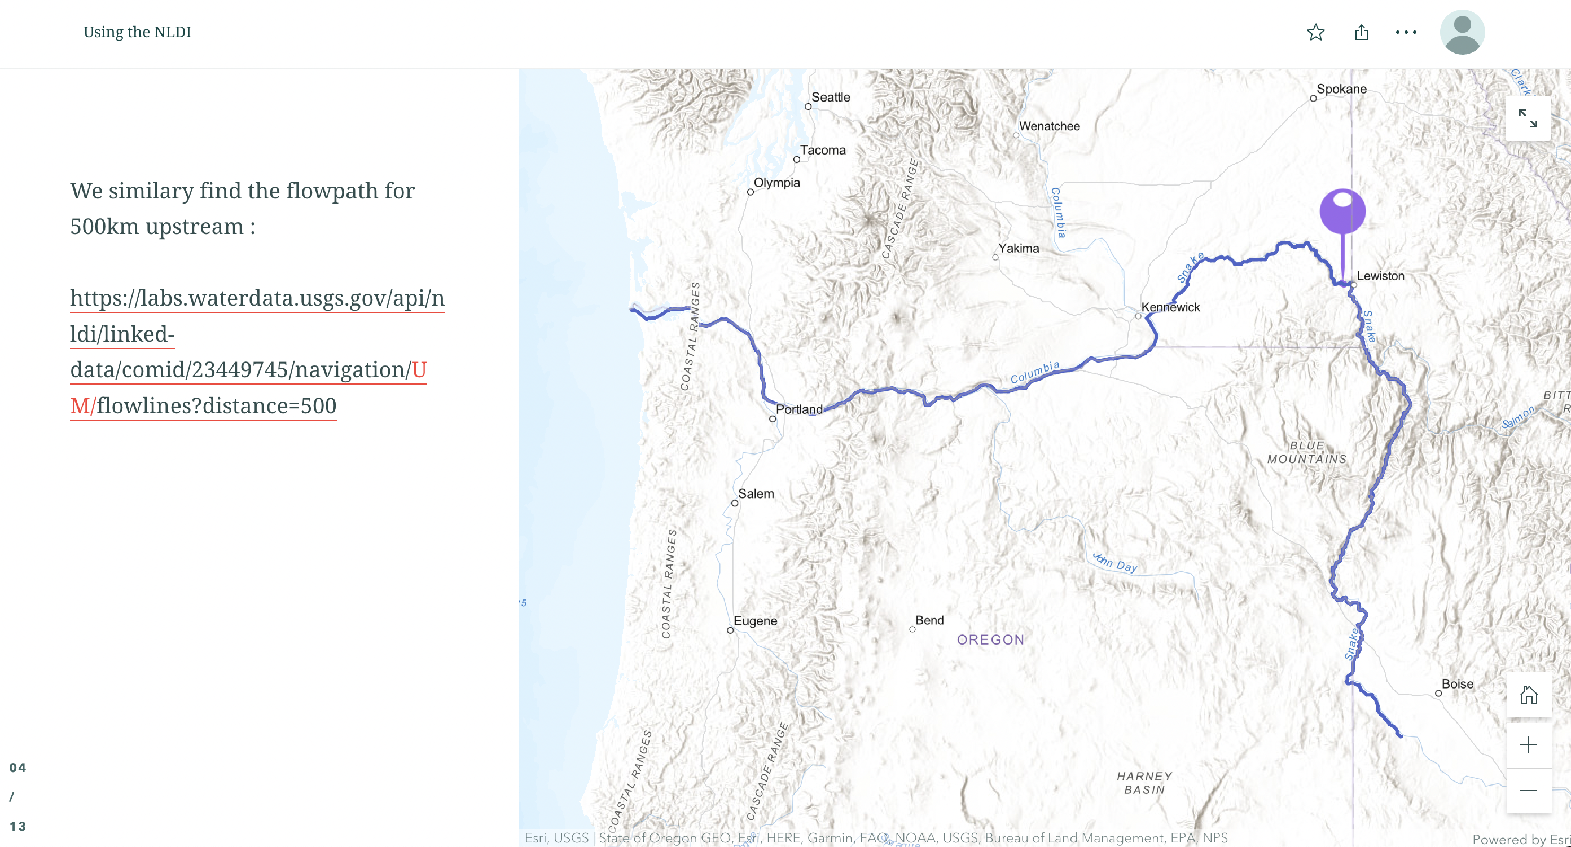

Slide 56
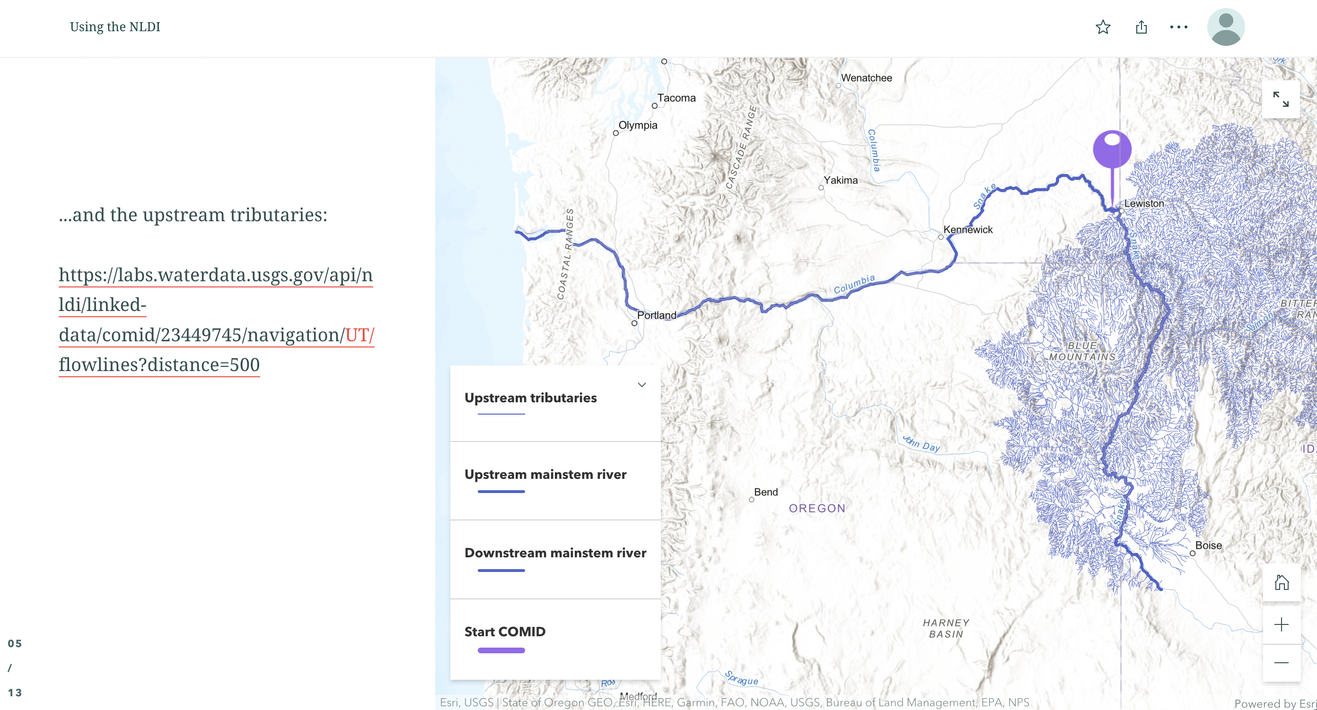

Slide 57
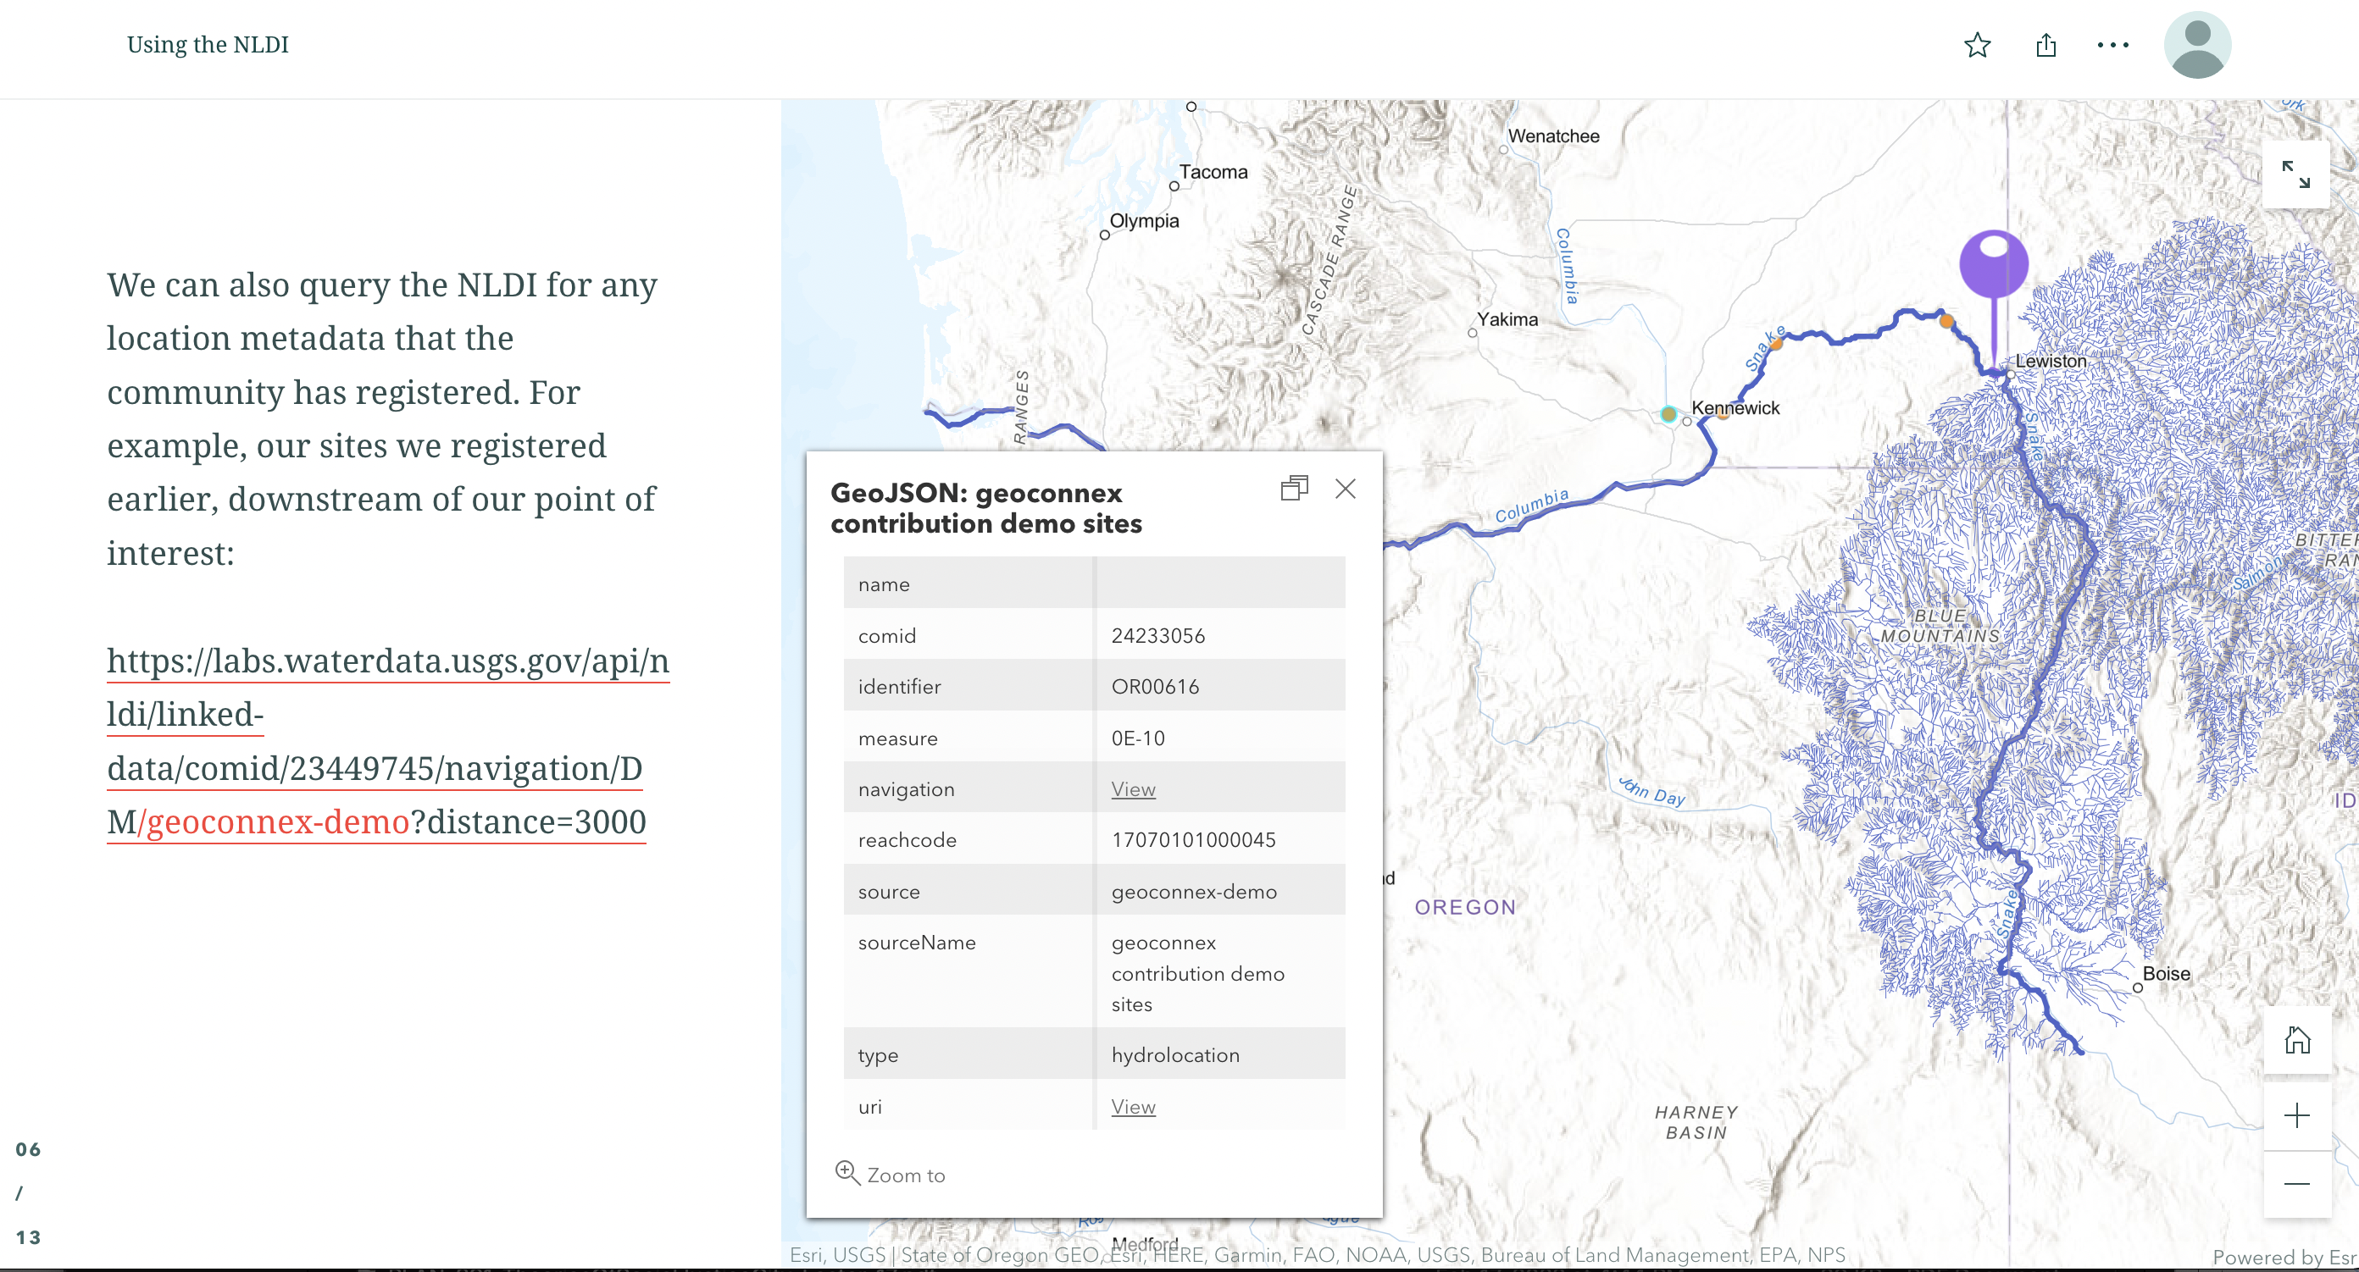

Slide 58
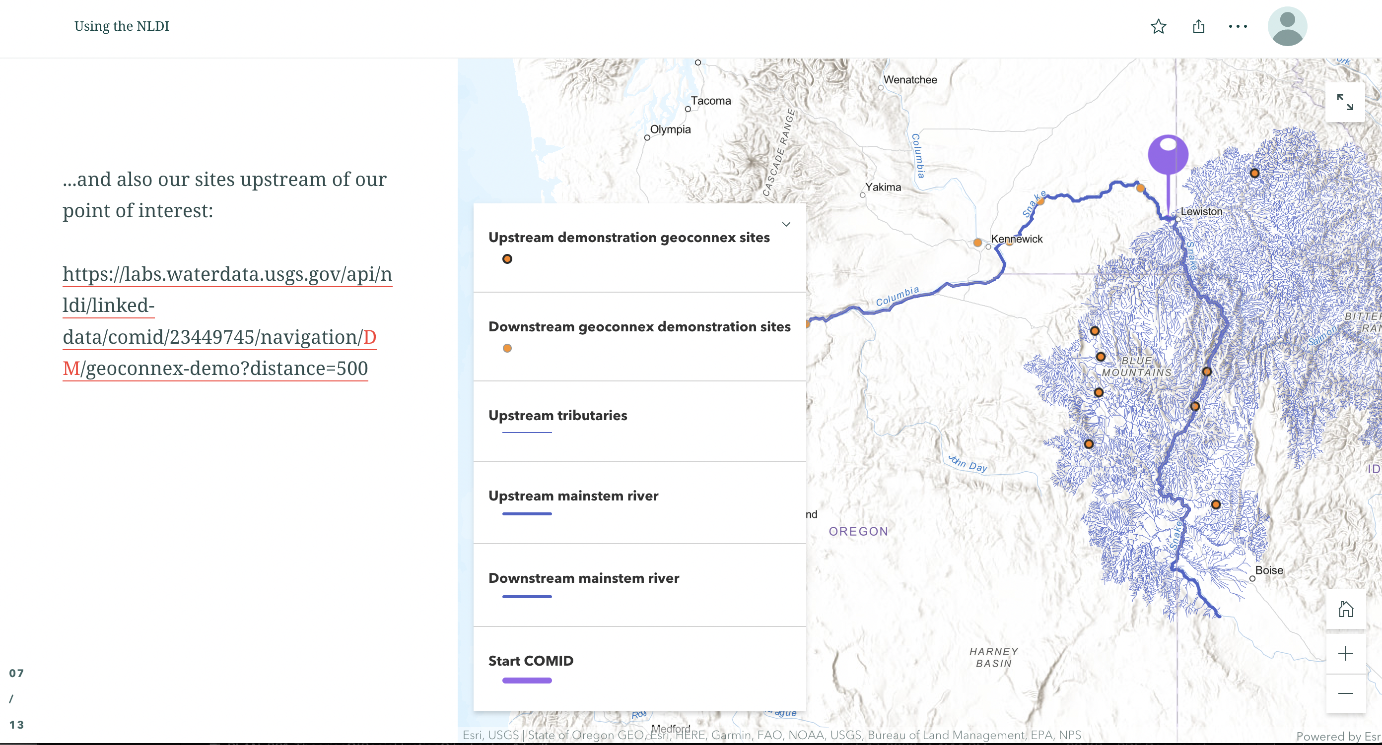

Slide 59
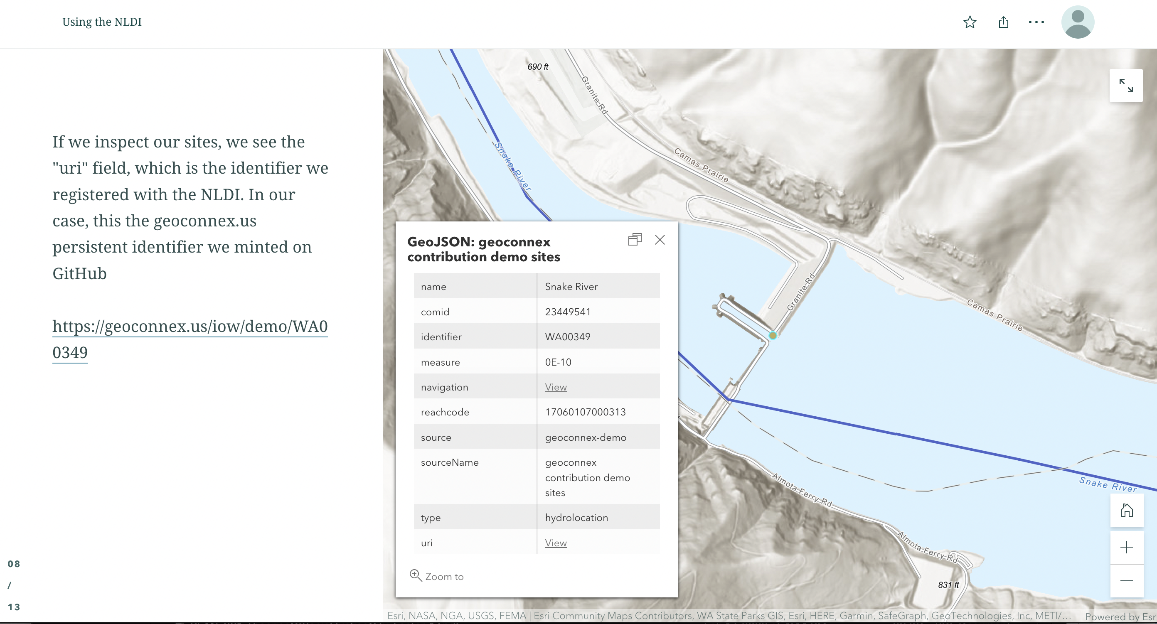

Slide 60
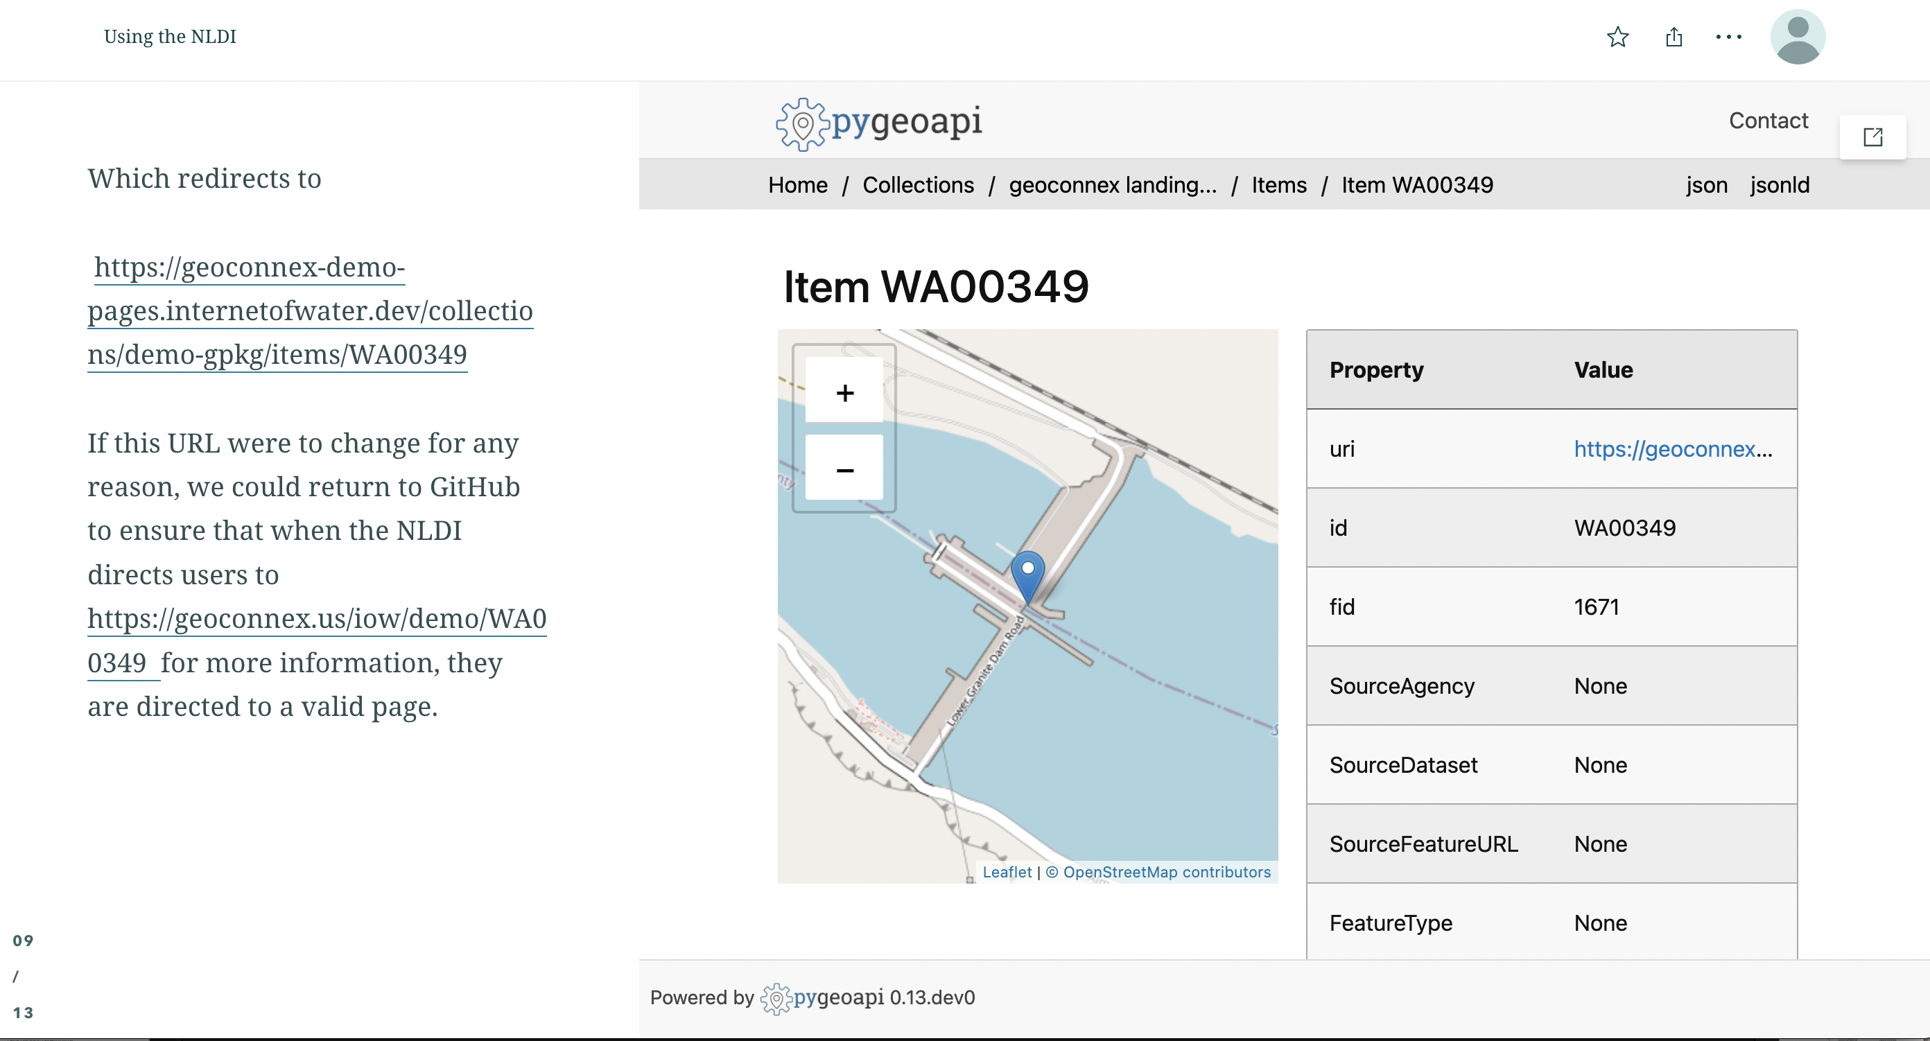

Slide 61
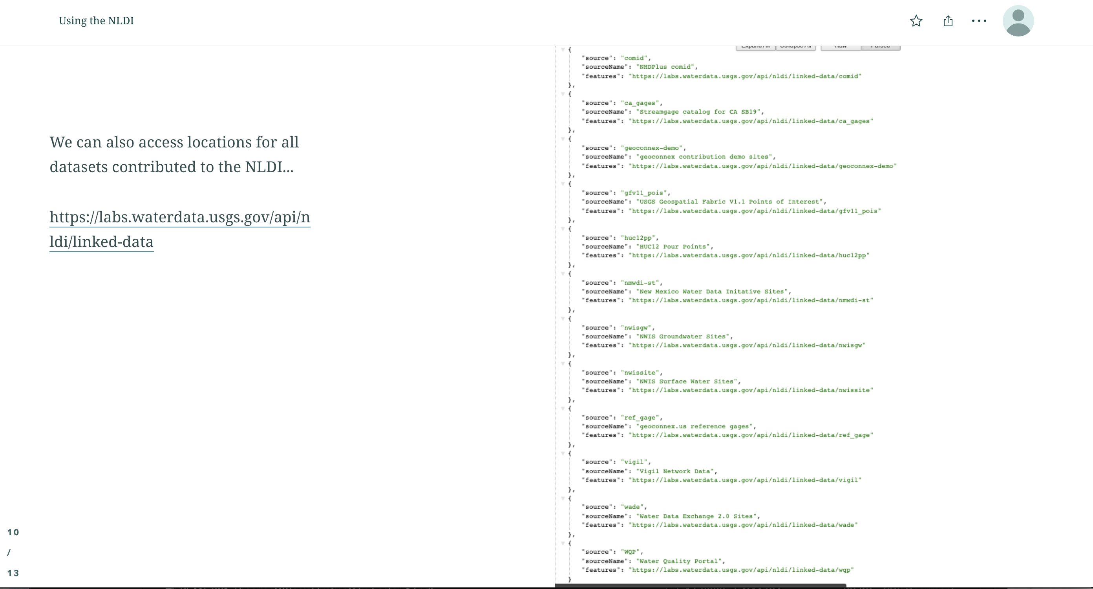

Slide 62
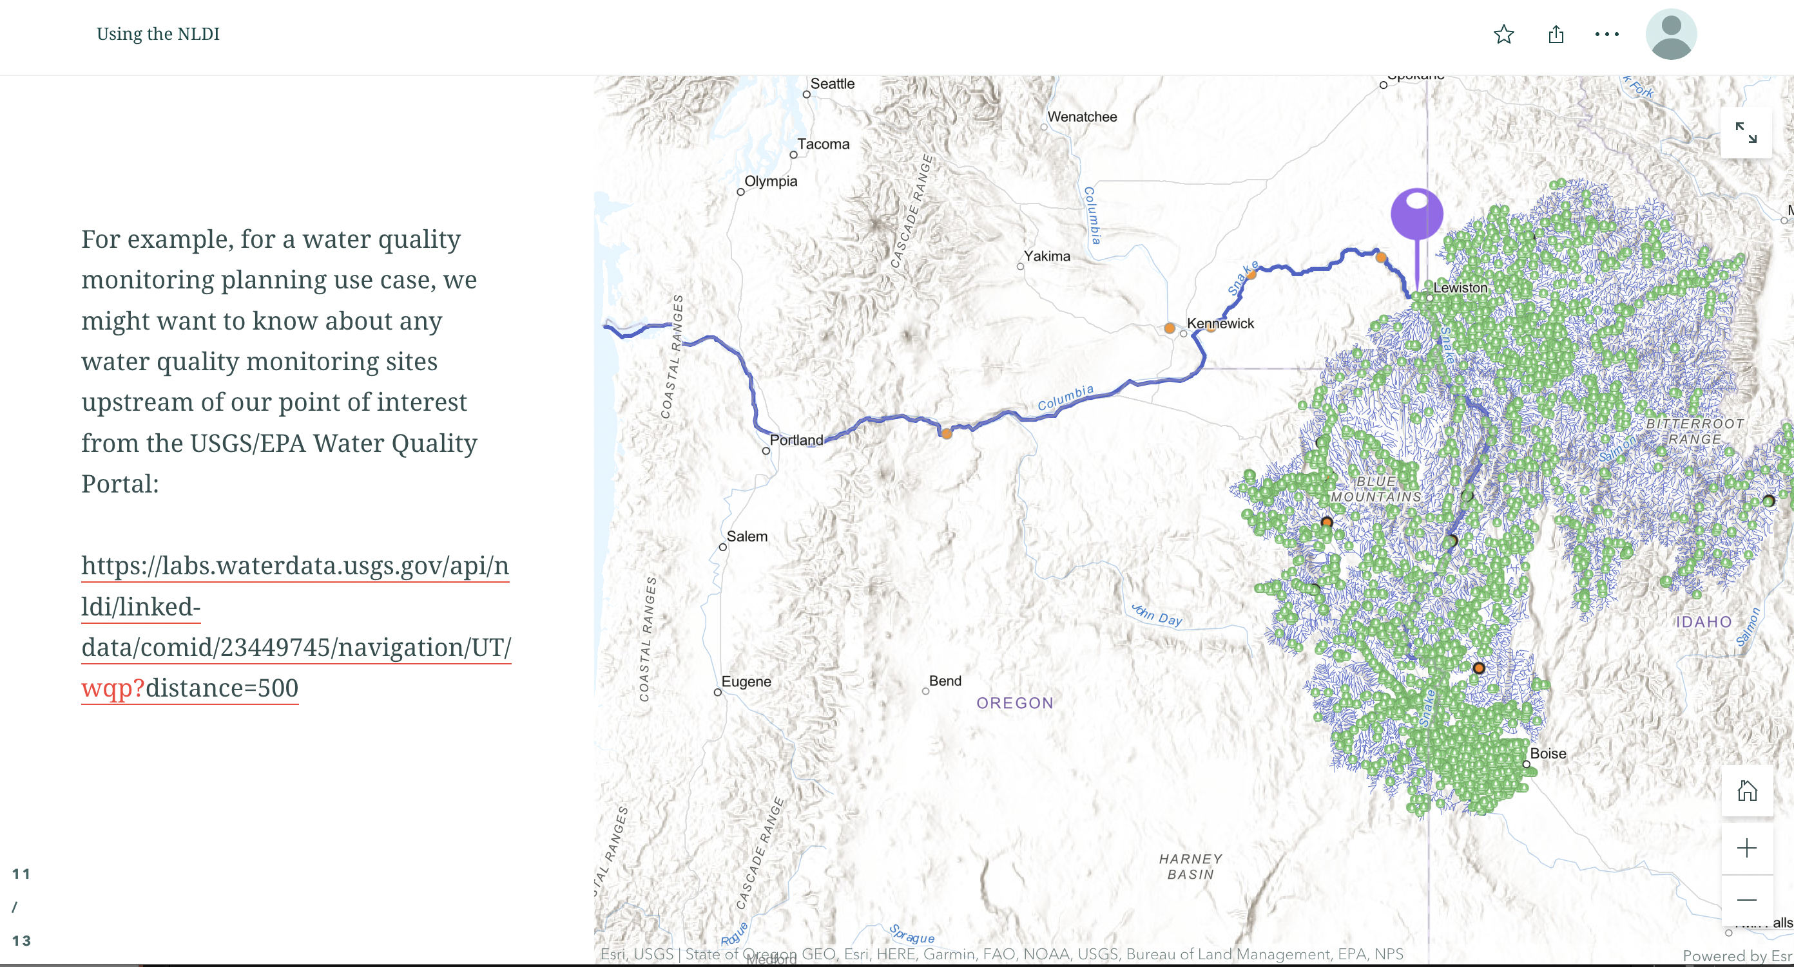

Slide 63
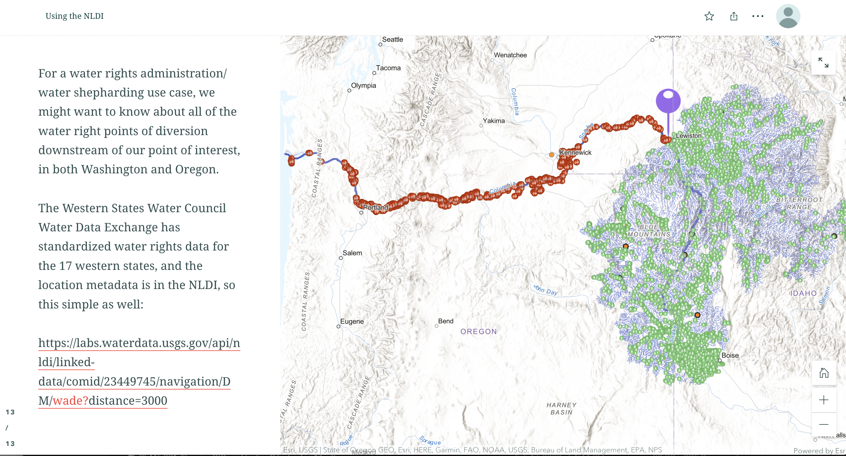

Slide 64
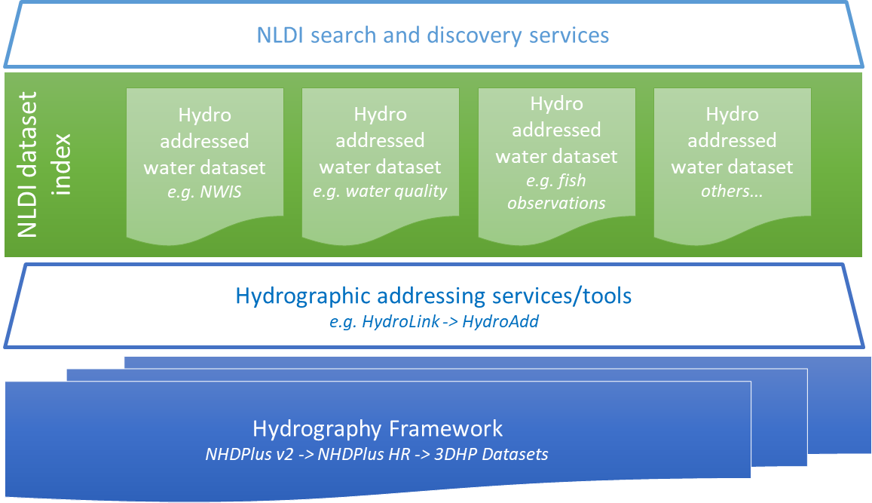
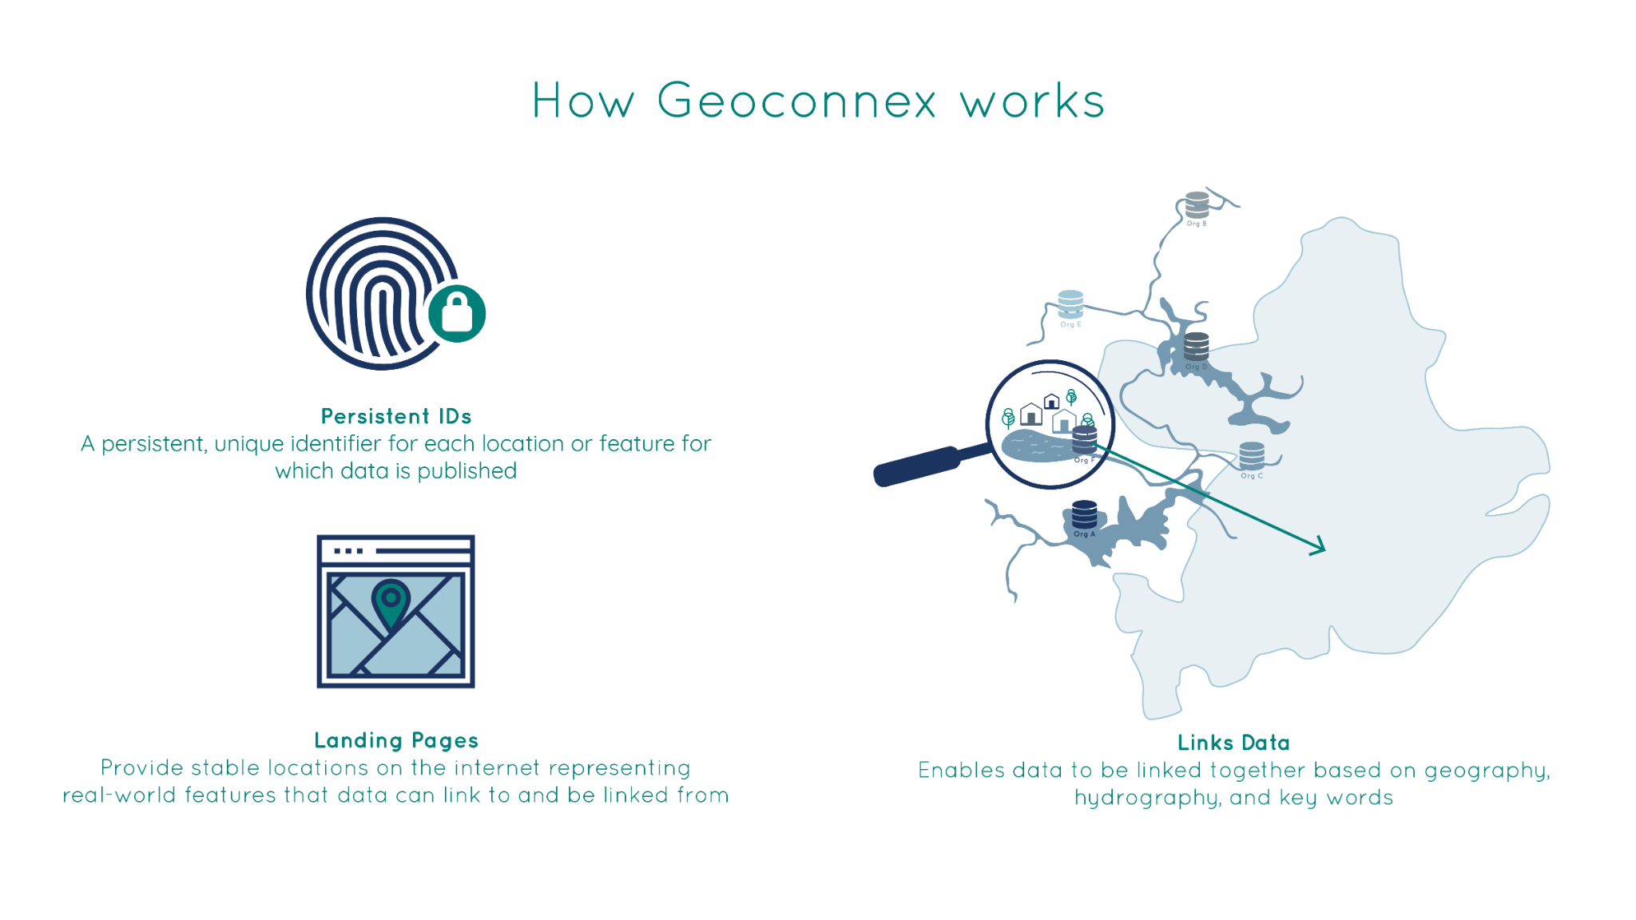

3DHP Infostructure
an internet of water
HubKit
Extraction
A free, open-source software suite that lets data providers automate the process of ingesting data, standardizing data, serving through an API, and serving relevant metadata
Guidance and basic data extraction tools that make it easier for users to access data from already existing hubs, such as Water Quality Portal
Search engines
Applications
Notes:
So, in working with USGS, we imagine geoconnex serving as a kind catalog for data that has been addressed to the national hydrography, the national stream network (and hopefully at some point, also groundwater features), which will be mainained by the new USGS 3D hydrography program “Infostructure”, which ill include tools to create hydrologic addresses for any user’s data. Becci Anderson from USGS is going to talk in more detail after me about that, so just know these two projects are coordinating closely.

Slide 65
Thank you
Geoconnex Documentation at https://docs.geoconnex.us
Reach out for help by submitting an issue to
https://github.com/internetofwater/geoconnex.us
NLDI Documentation at https://geoconnex.us/iow/nldi
For questions about either service
Kyle Onda (Lincoln Institute): konda@lincolninst.edu
David Blodgett (USGS): dblodgett@usgs.gov

